Slide 1
Chapter 7 Arrays and ArrayLists

Slide 2
7.1 Introduction
Arrays
Data structures consisting of related data items of the same type.
Make it convenient to process related groups of values.
Remain the same length once they are created.
Enhanced for statement for iterating over an array or collection of data items.
Variable-length argument lists
Can create methods are with varying numbers of arguments.
Process command-line arguments in method main.

Slide 3
7.1 Introduction (Cont.)
Common array manipulations with static methods of class Arrays from the java.util package.
ArrayList collection
Similar to arrays
Dynamic resizing
They automatically increase their size at execution time to accommodate additional elements

Slide 4
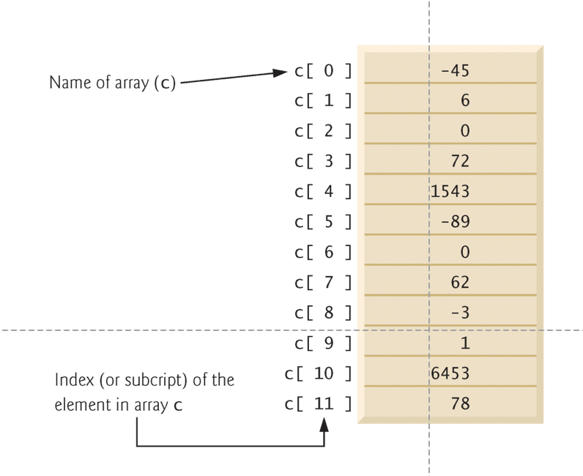
7.2 Arrays
Array
Group of variables (called elements)
containing values of the same type.
Arrays are objects so they are reference types.
Elements can be either primitive or reference types.
Refer to a particular element in an array
Use the element’s index.
Array-access expression—the name of the array followed by the index of the particular element in square brackets, [].
The first element in every array has index zero.

Slide 5
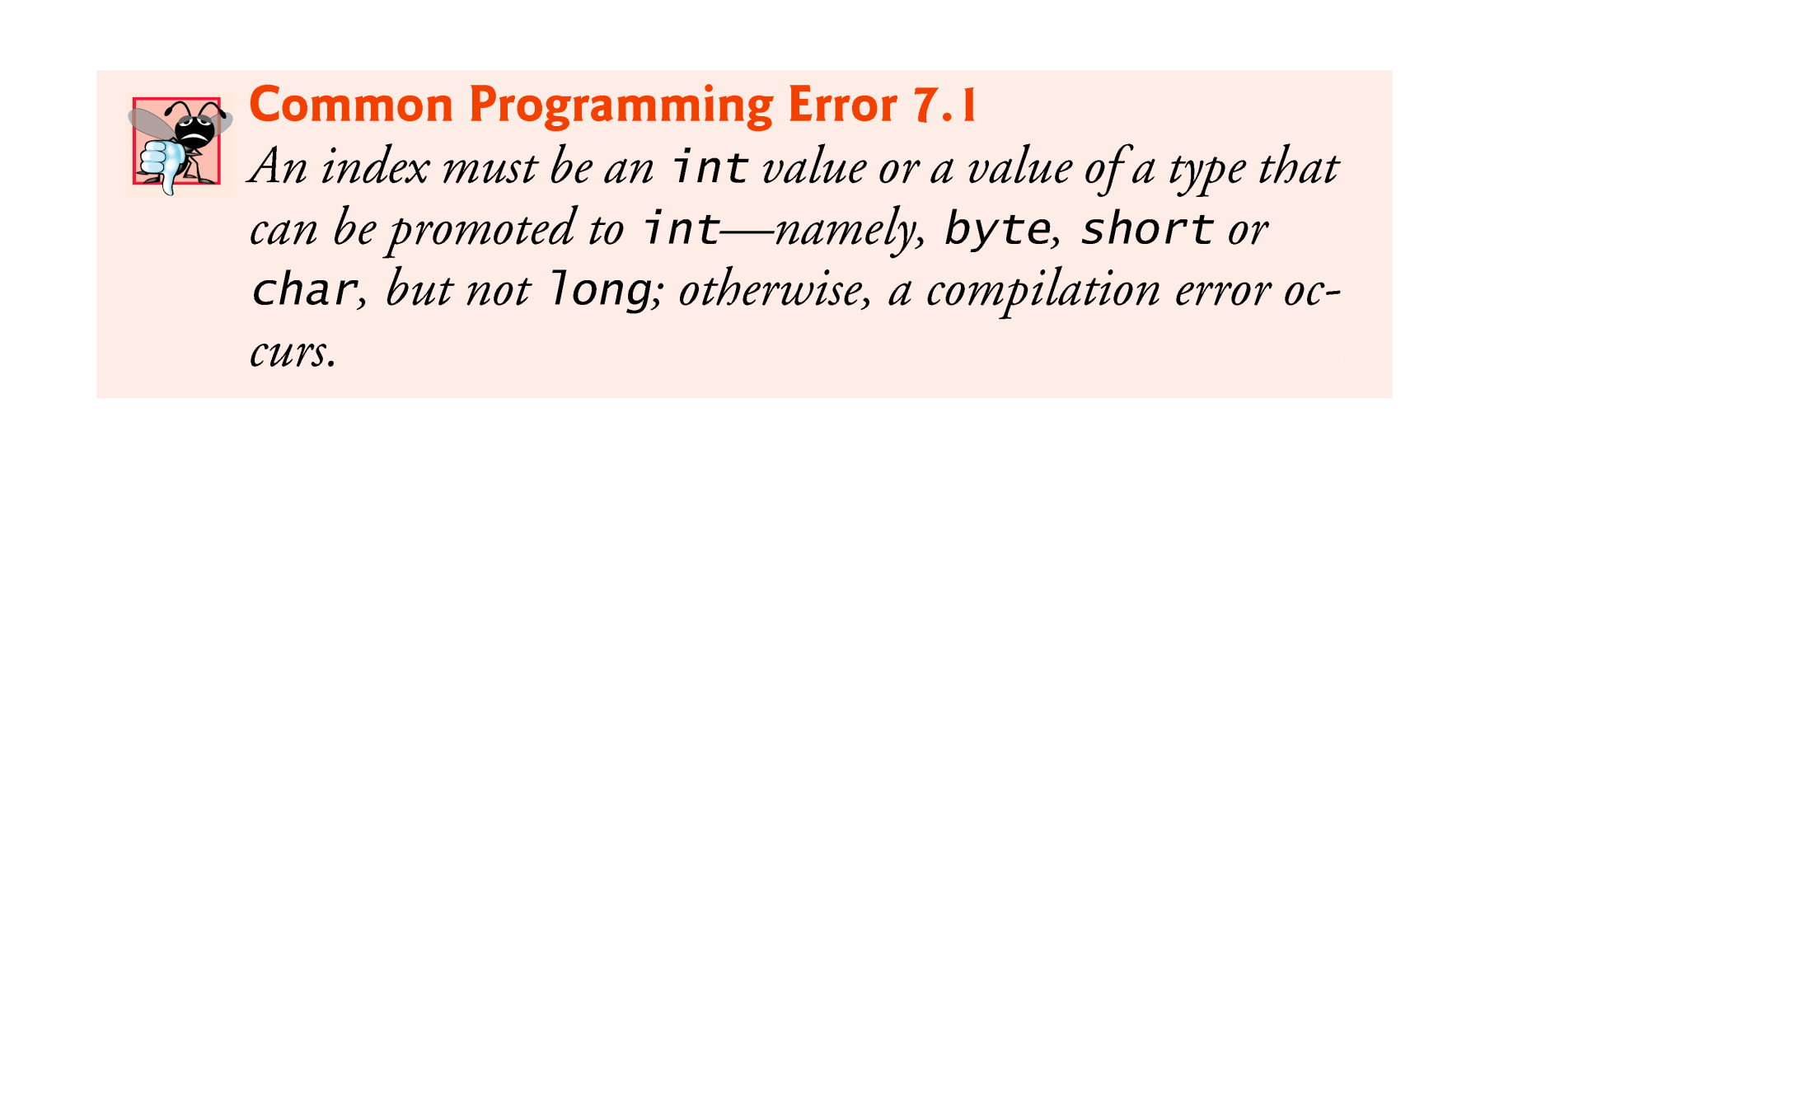
7.2 Arrays (Cont.)
Every array object knows its own length and stores it in a length instance variable.
length cannot be changed because it’s a final variable.

Slide 6
7.3 Declaring and Creating Arrays
Declaration and array-creation expression for an array of 12 int elements
int[] c = new int[ 12 ];
Can be performed in two steps as follows:
int[] c; // declare the array variable c = new int[ 12 ]; // creates the array
When an array is created, each element of the array receives a default value
Zero for the numeric primitive-type elements, false for boolean elements and null for references.

Slide 7
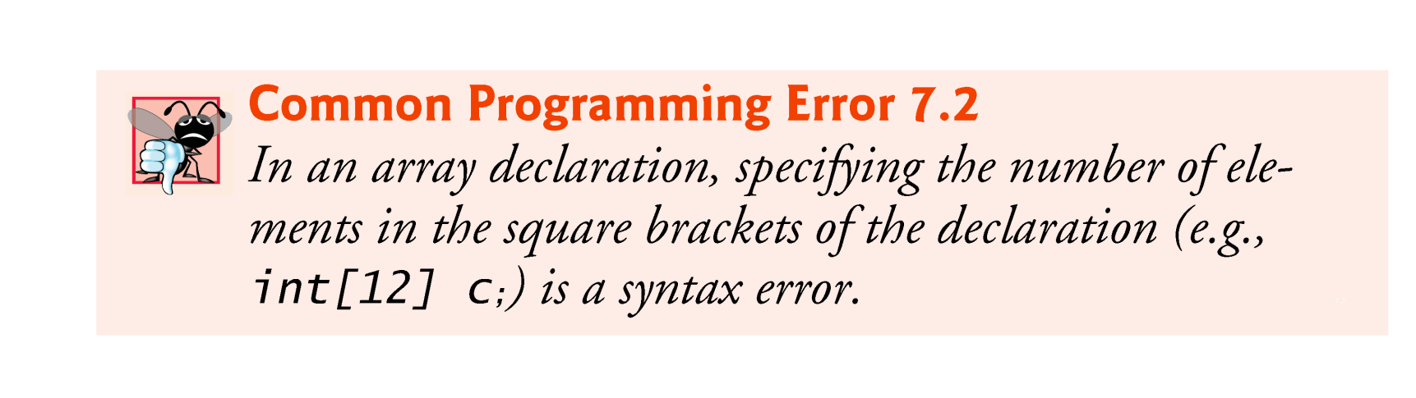

Slide 8
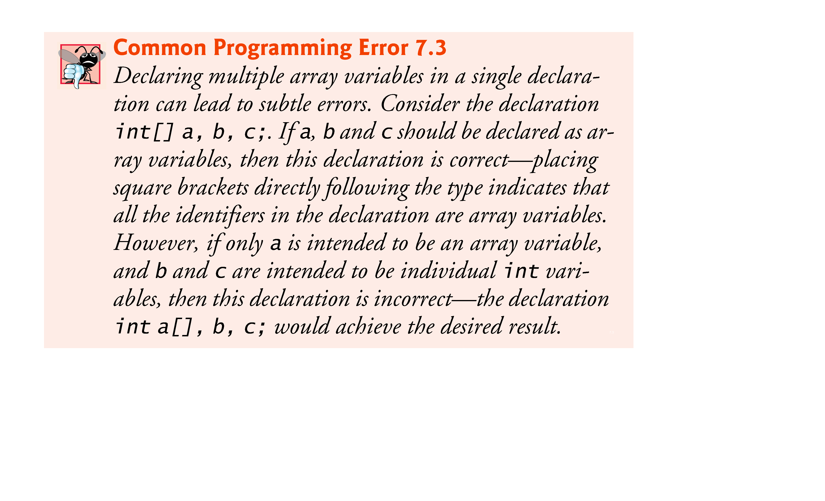

Slide 9
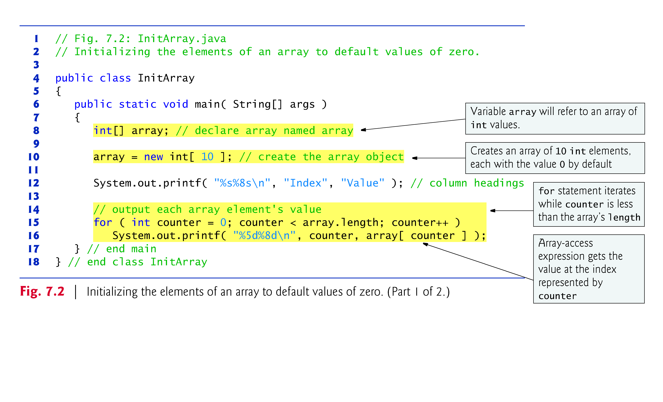
7.4 Examples Using Arrays

Slide 10
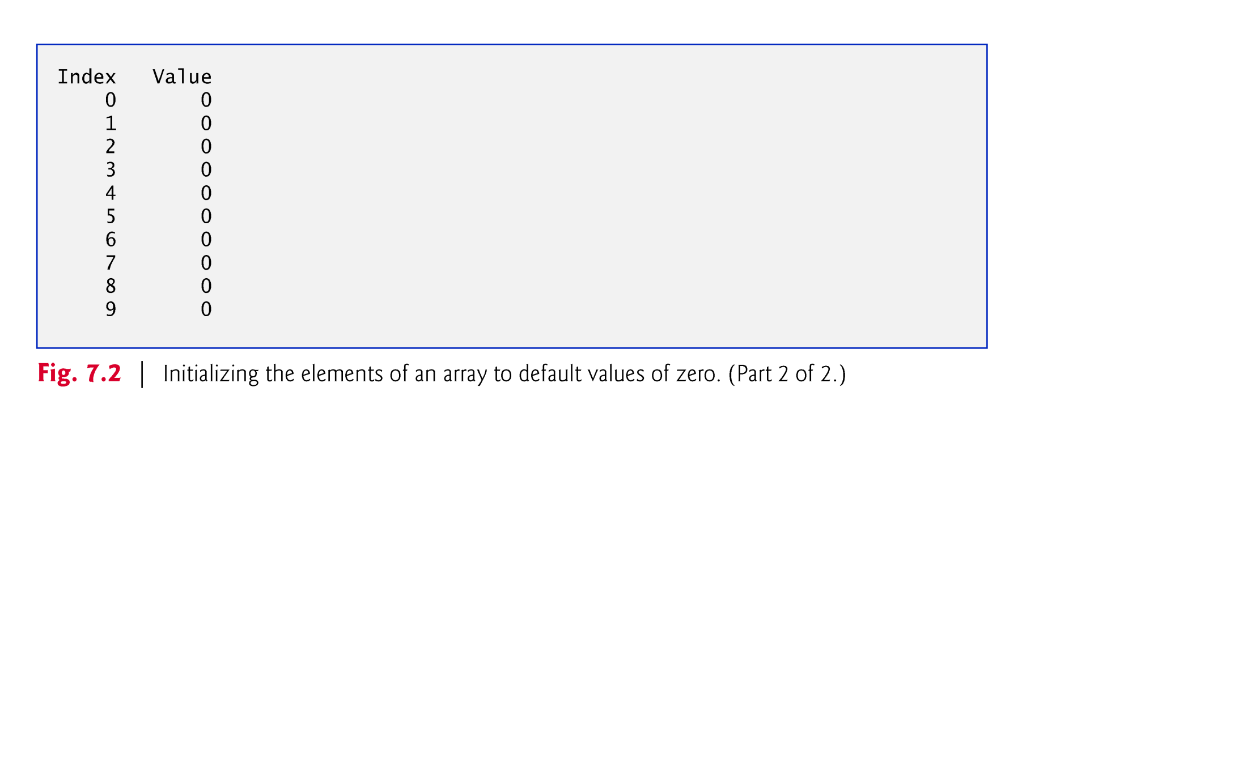

Slide 11
7.4 Examples Using Arrays (Cont.)
Array initializer
A comma-separated list of expressions (called an initializer list) enclosed in braces.
int[] n = { 10, 20, 30, 40, 50 };
Creates a five-element array with index values 0–4.
Compiler counts the number of initializers in the list to determine the size of the array
Sets up the appropriate new operation “behind the scenes.”

Slide 12
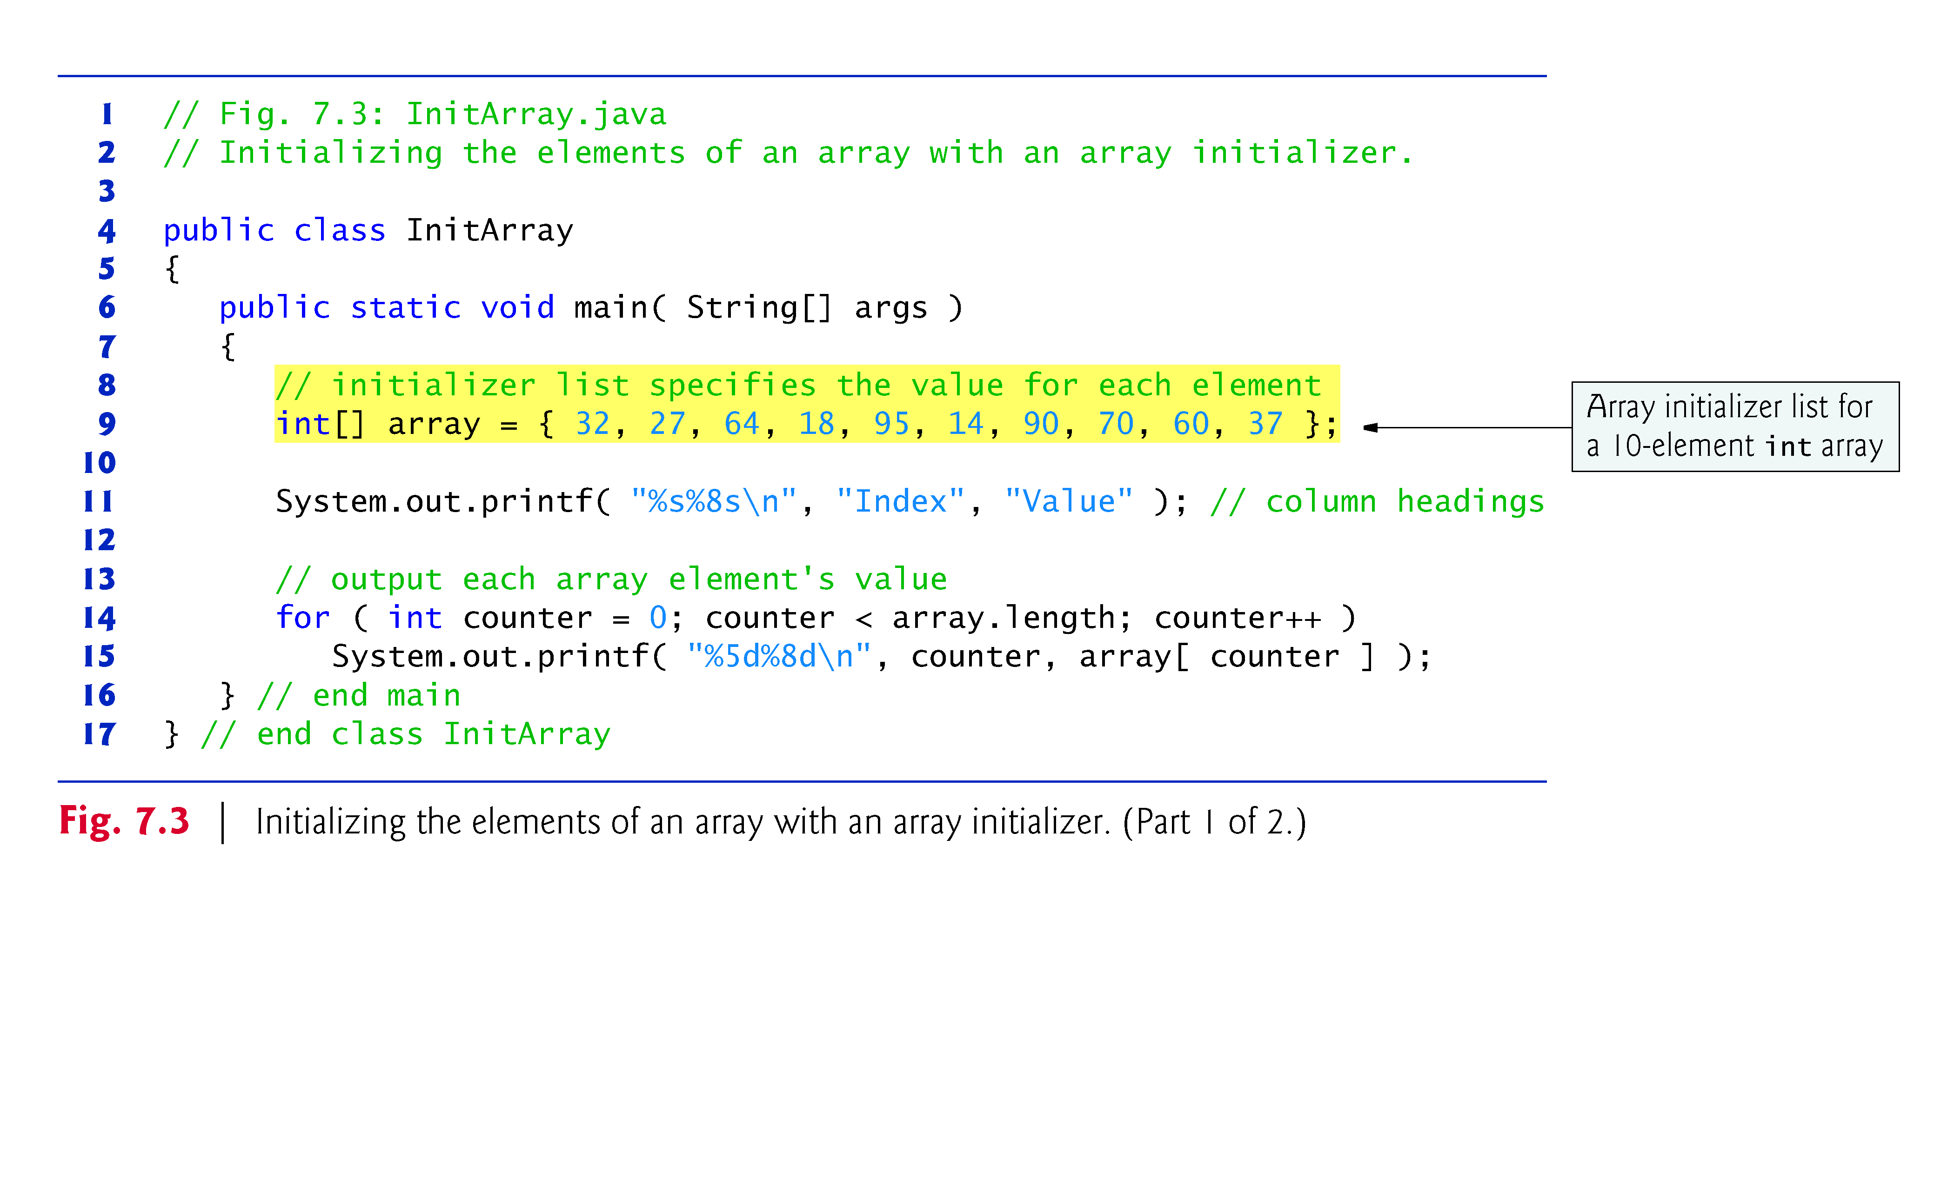

Slide 13


Slide 14
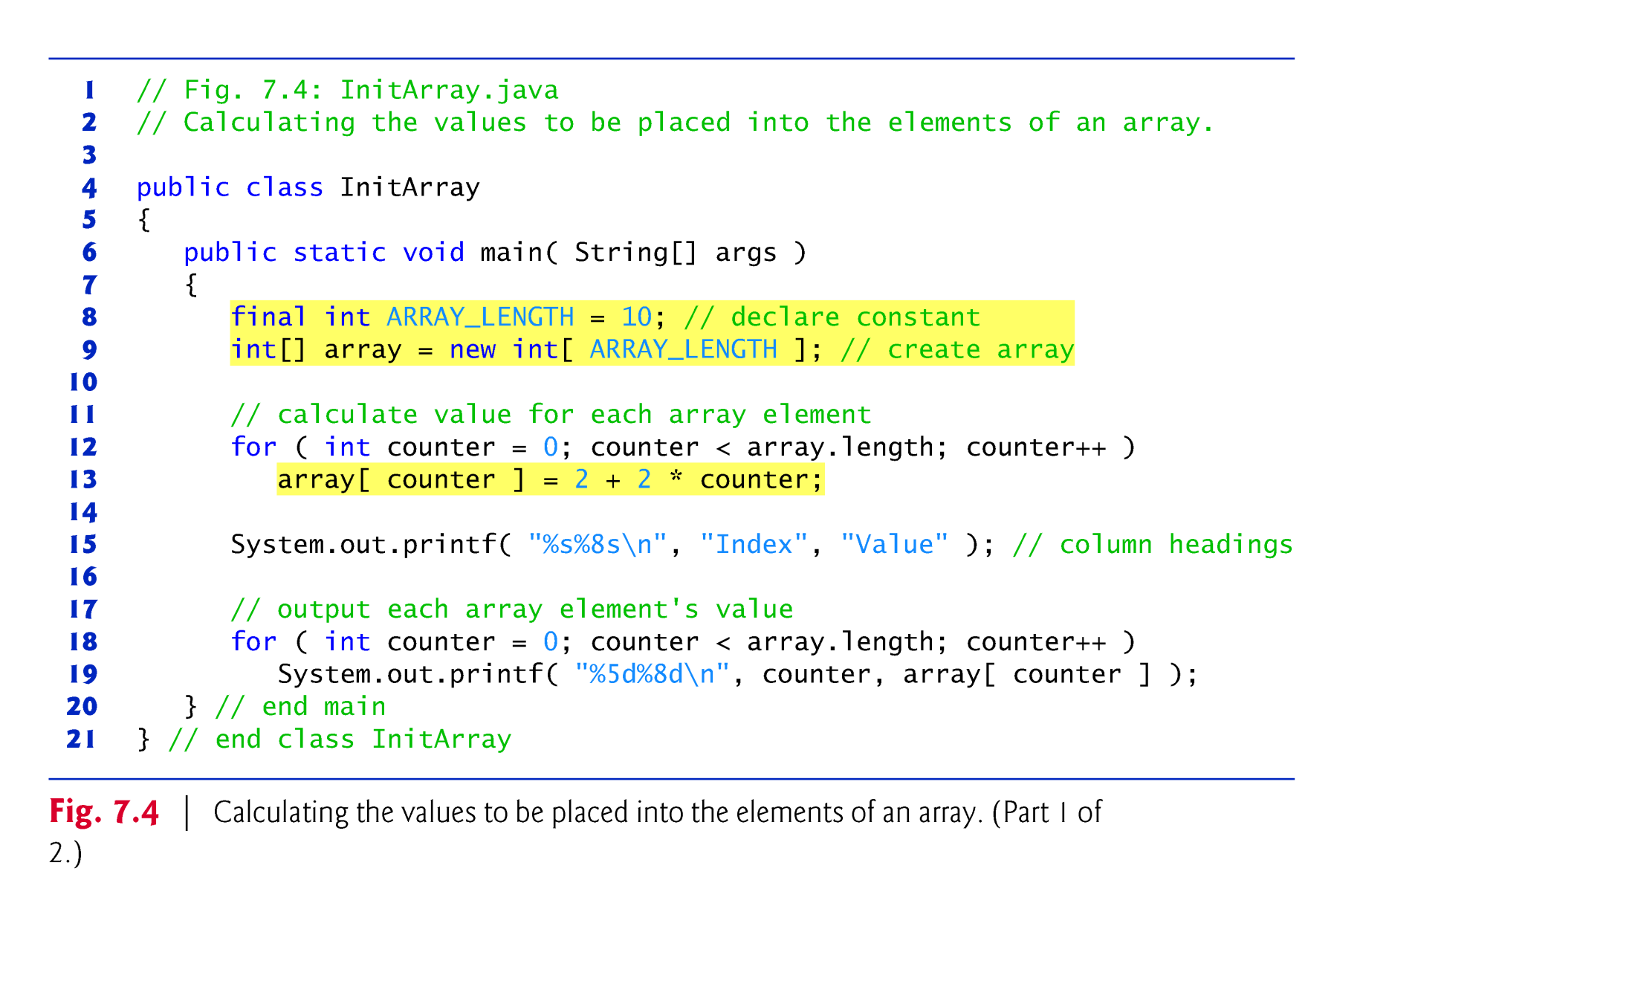
7.4 Examples Using Arrays (Cont.)

Slide 15
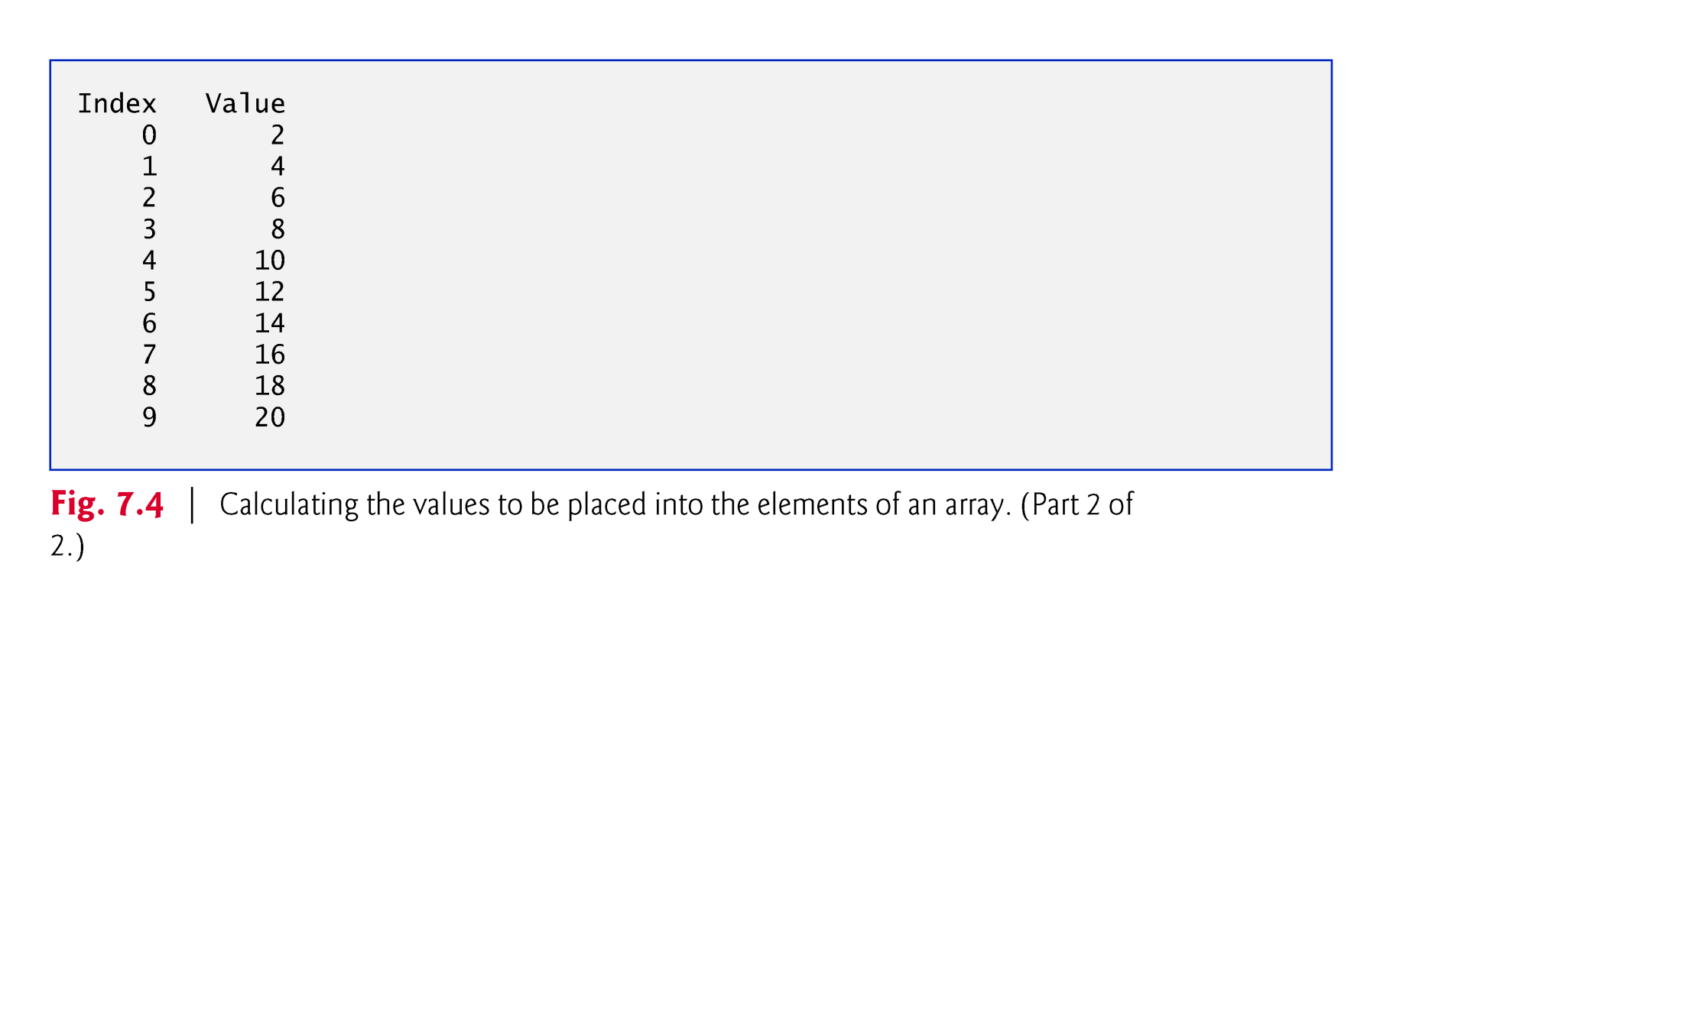

Slide 16
7.4 Examples Using Arrays (Cont.)
final variables must be initialized before they are used and cannot be modified thereafter.
An attempt to modify a final variable after it’s initialized causes a compilation error
cannot assign a value to final variable variableName
An attempt to access the value of a final variable before it’s initialized causes a compilation error
variable variableName might not have been initialized

Slide 17
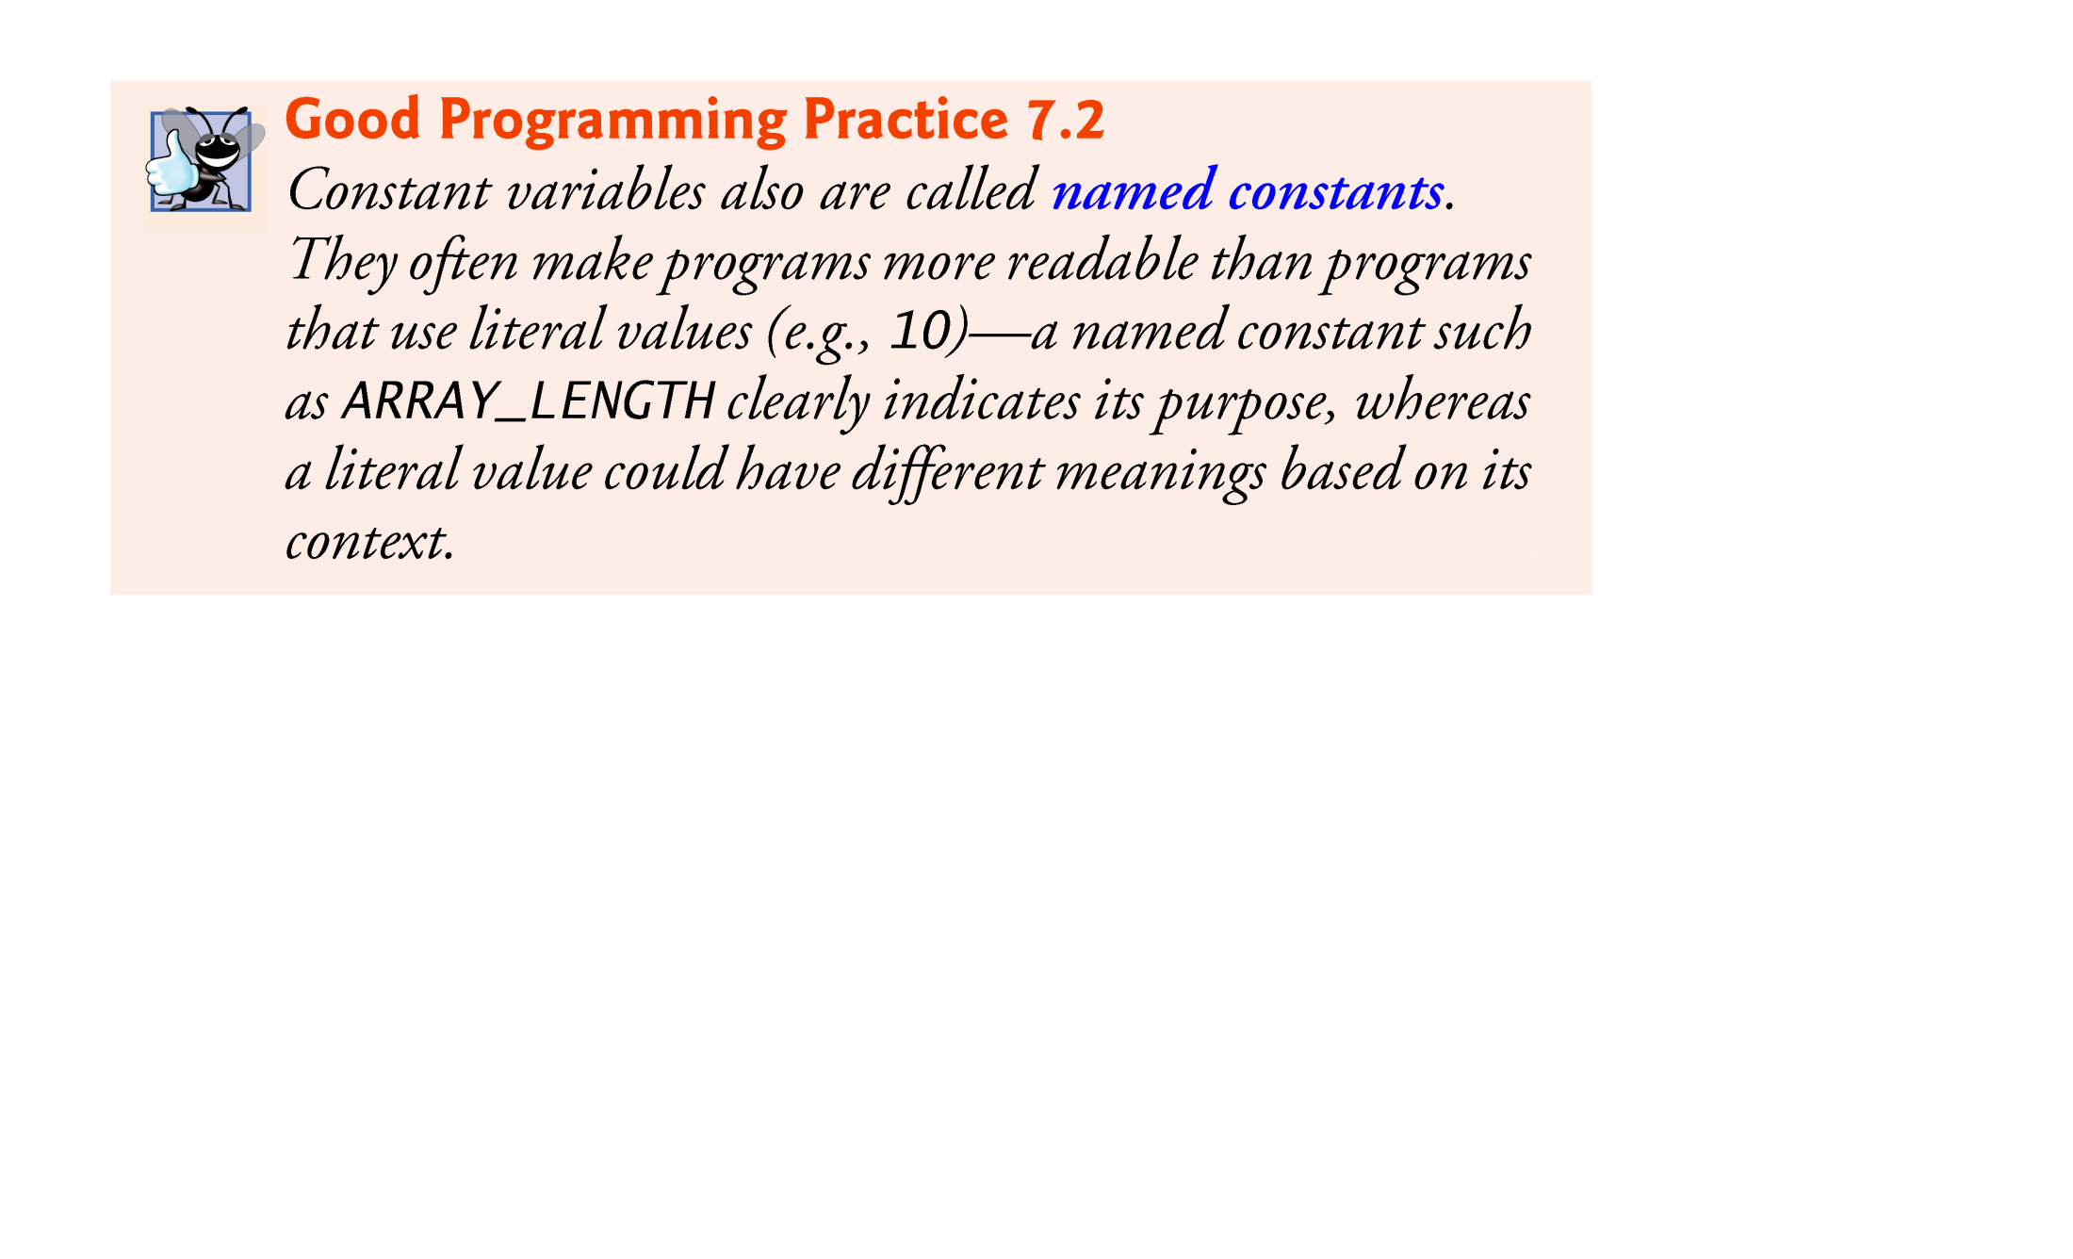
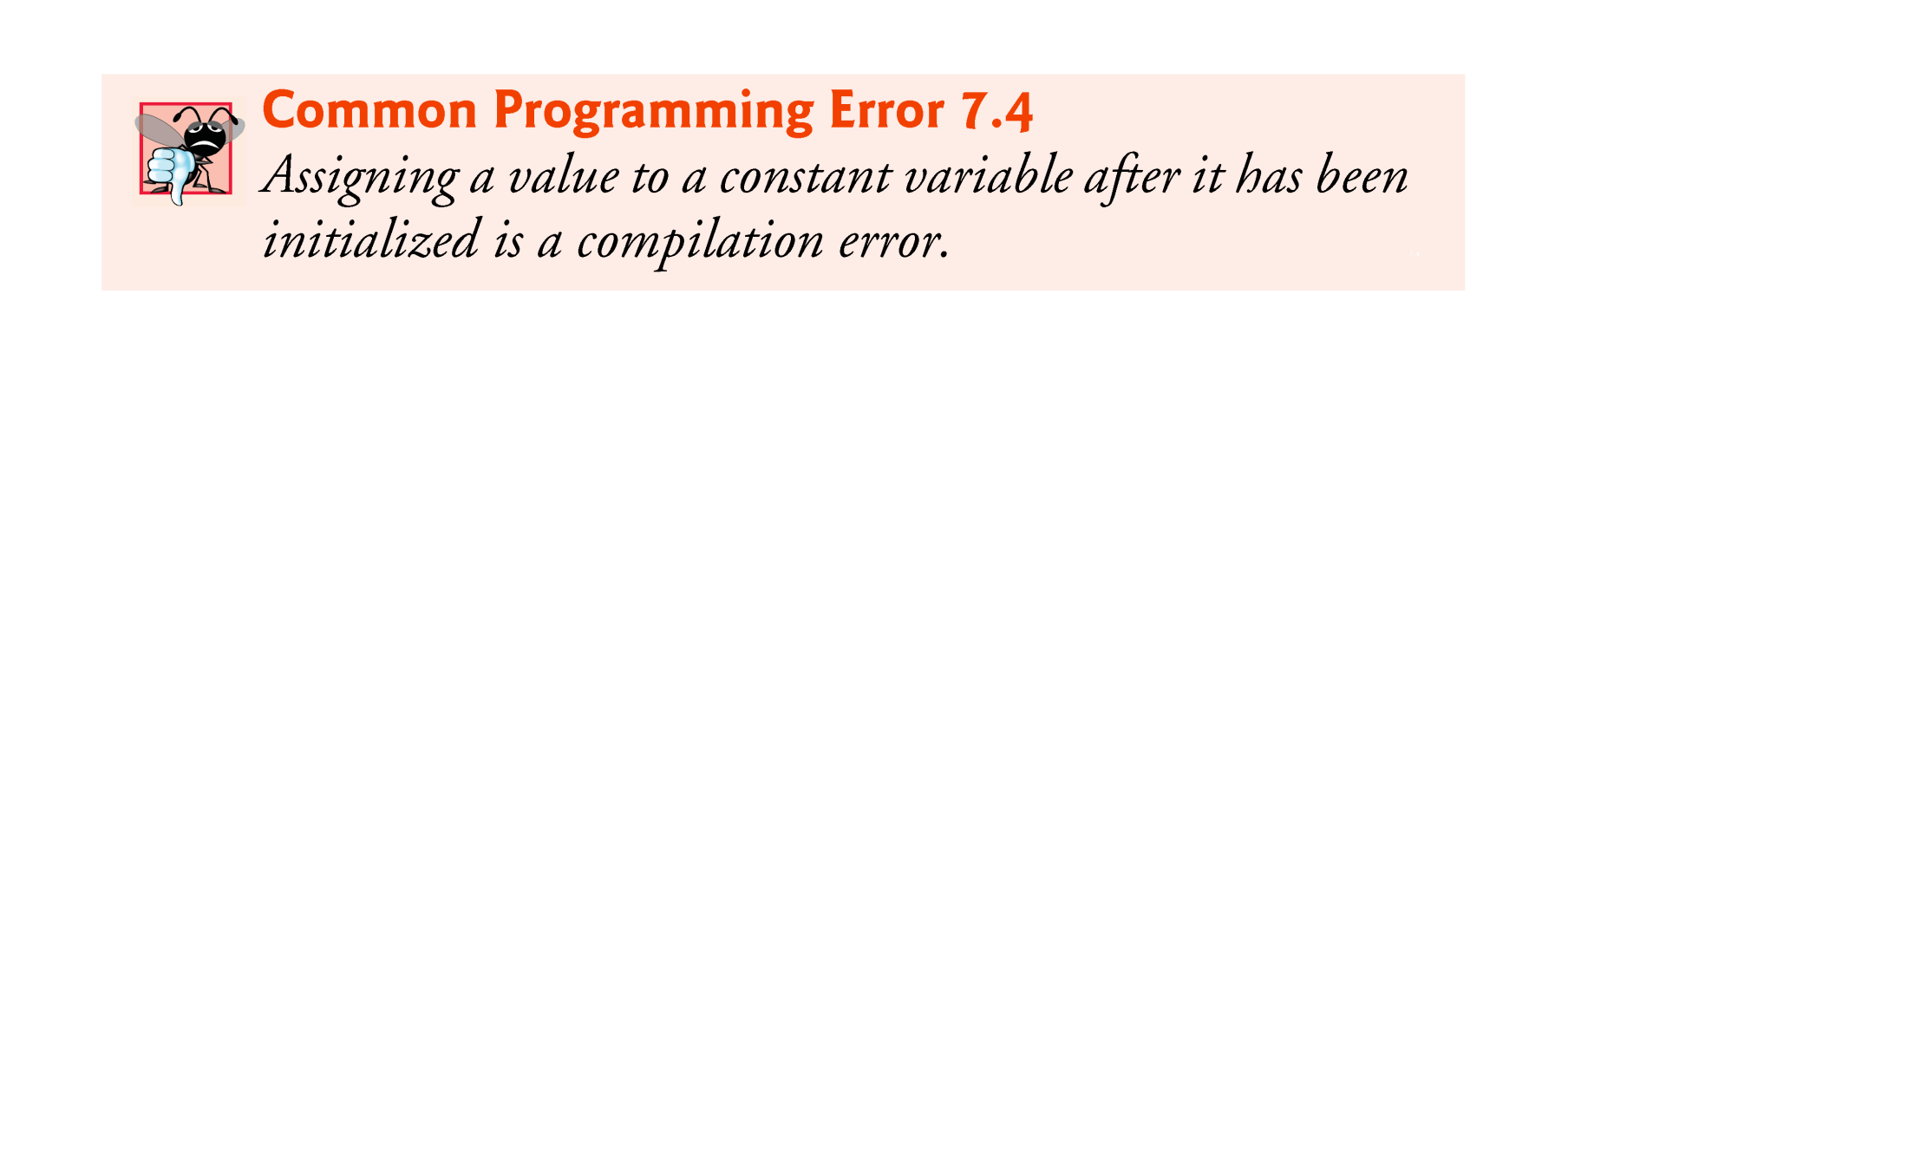

Slide 18
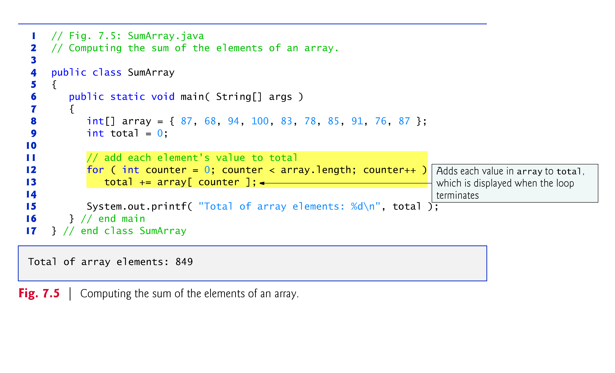

Slide 19
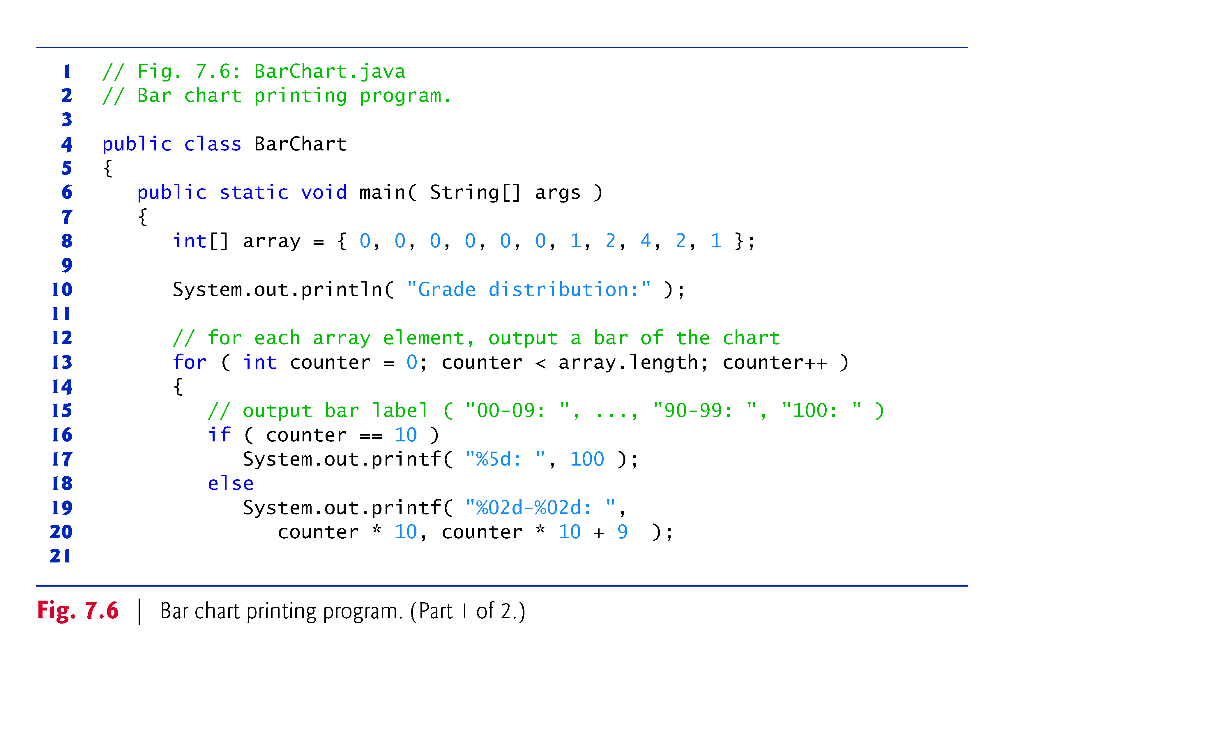

Slide 20
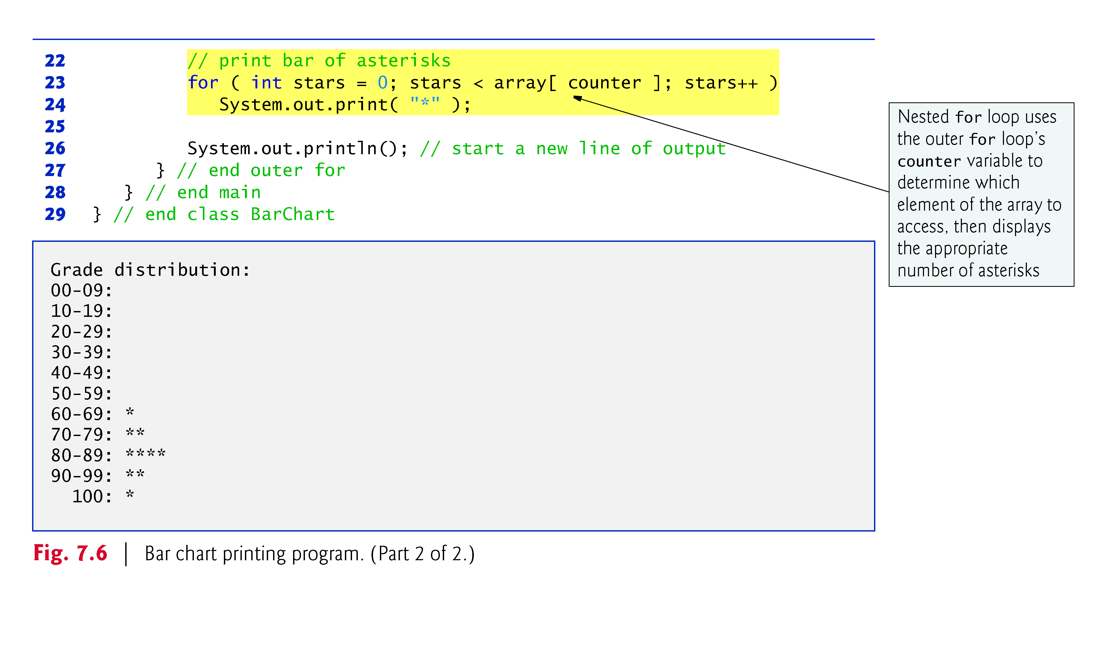

Slide 21
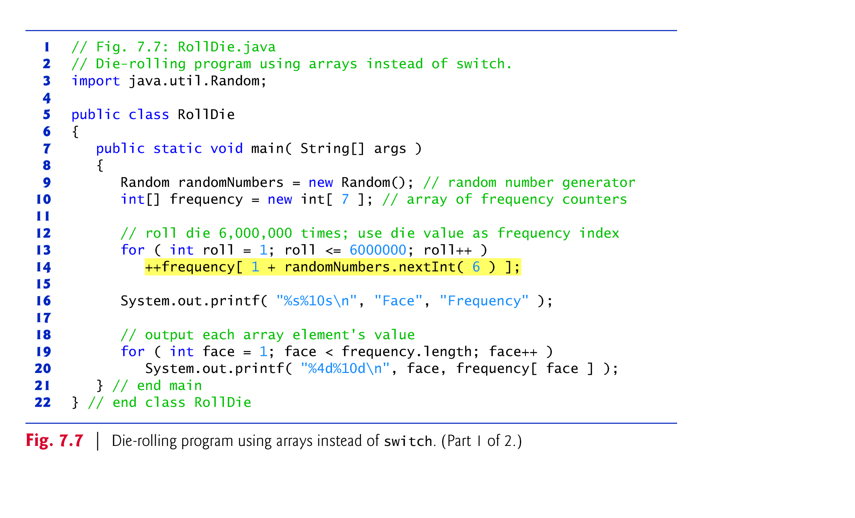

Slide 22
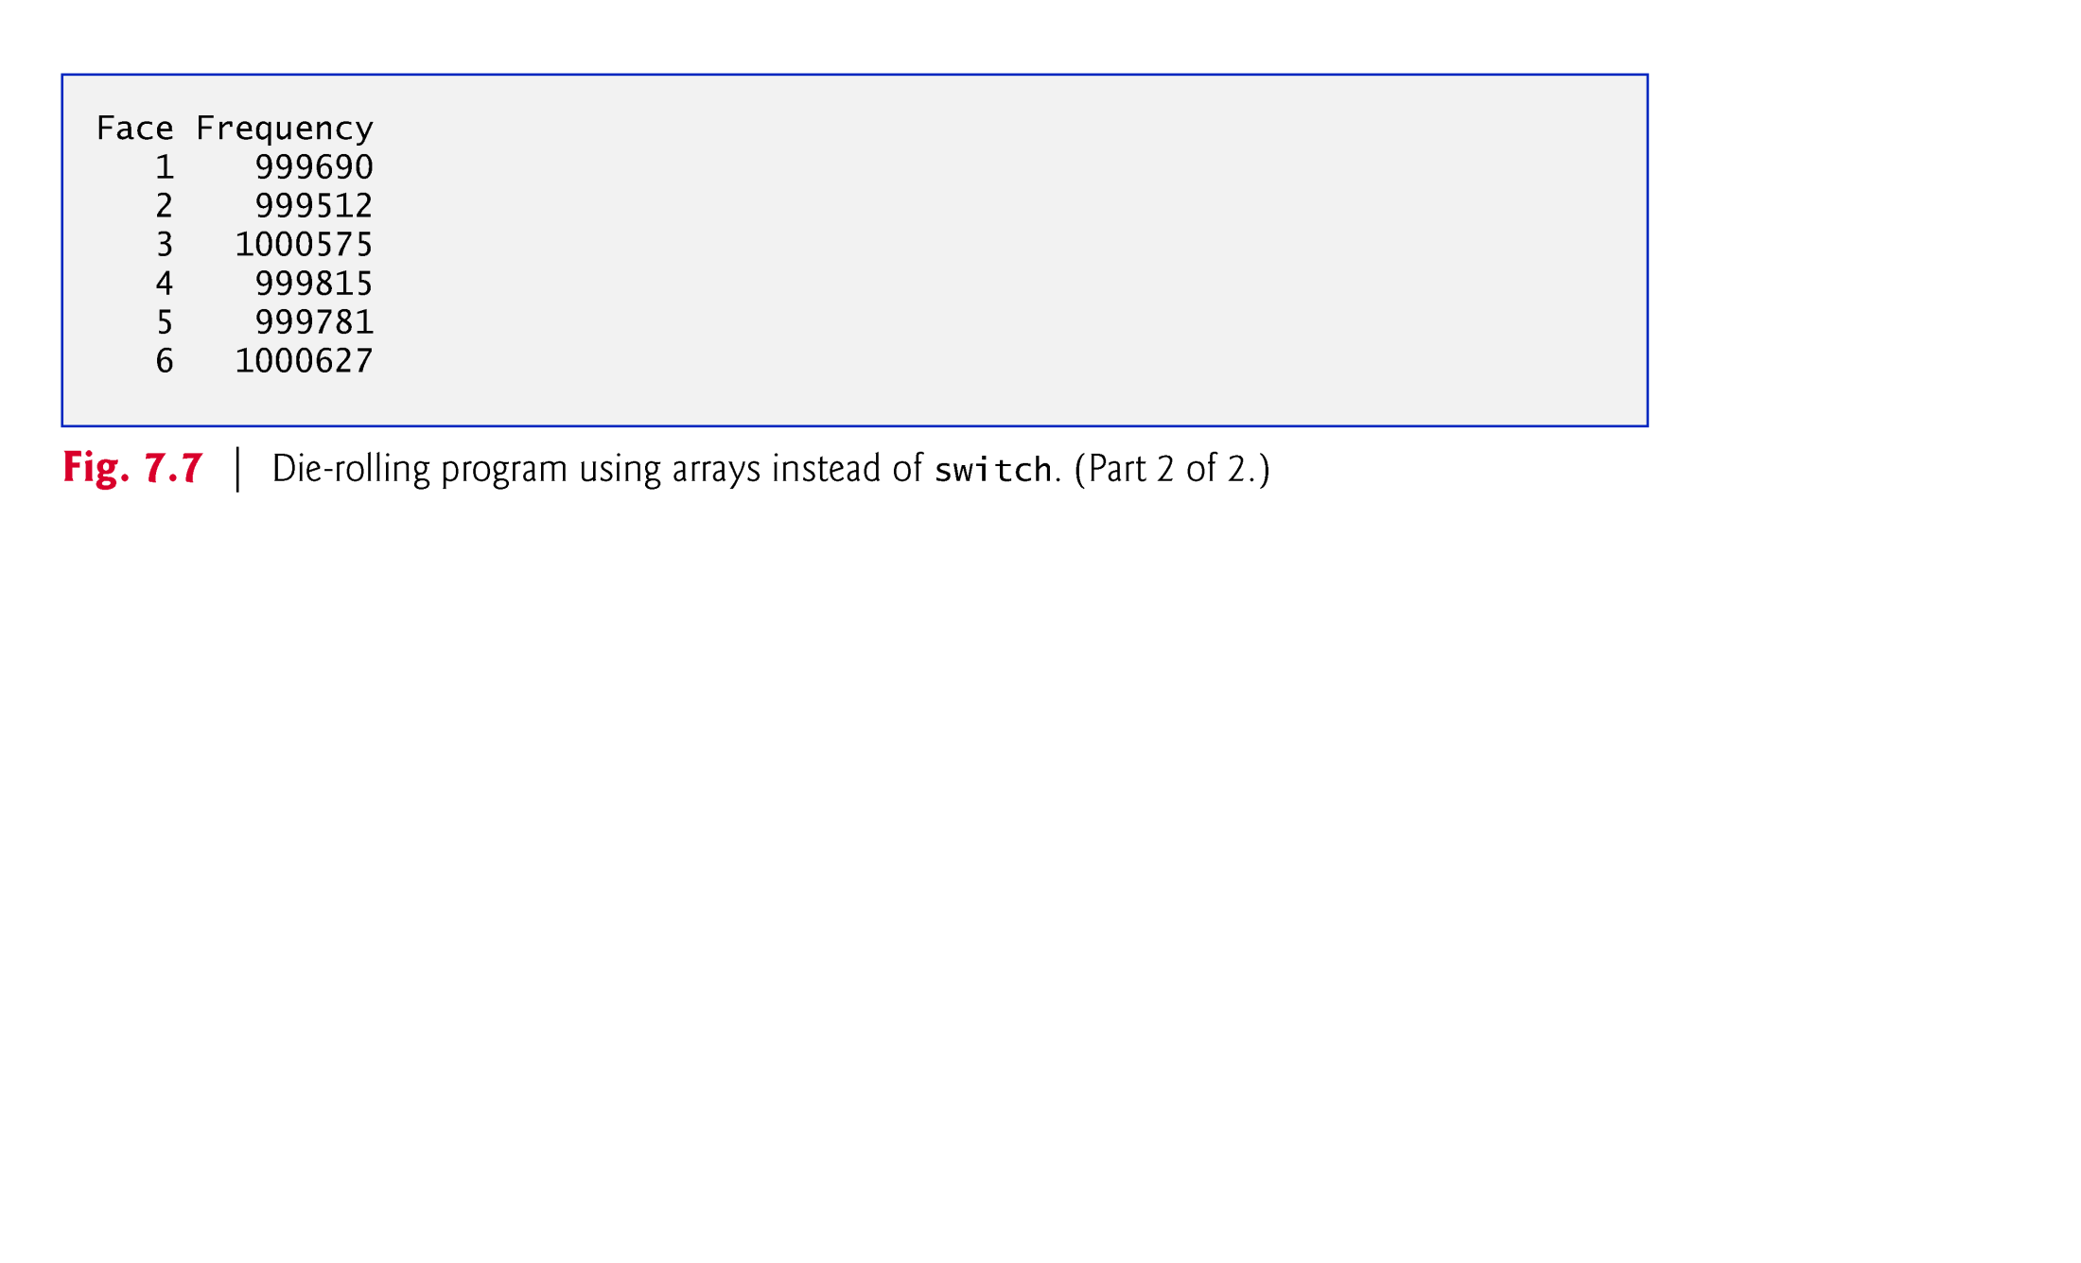

Slide 23
7.4 Examples Using Arrays (Cont.)
Figure 7.8 uses arrays to summarize the results of data collected in a survey:
Twenty students were asked to rate on a scale of 1 to 5 the quality of the food in the student cafeteria, with 1 being “awful” and 5 being “excellent.” Place the 20 responses in an integer array and determine the frequency of each rating.
Array responses is a 20-element int array of the survey responses.
6-element array frequency counts the number of occurrences of each response (1 to 5).
Each element is initialized to zero by default.
We ignore frequency[0].

Slide 24
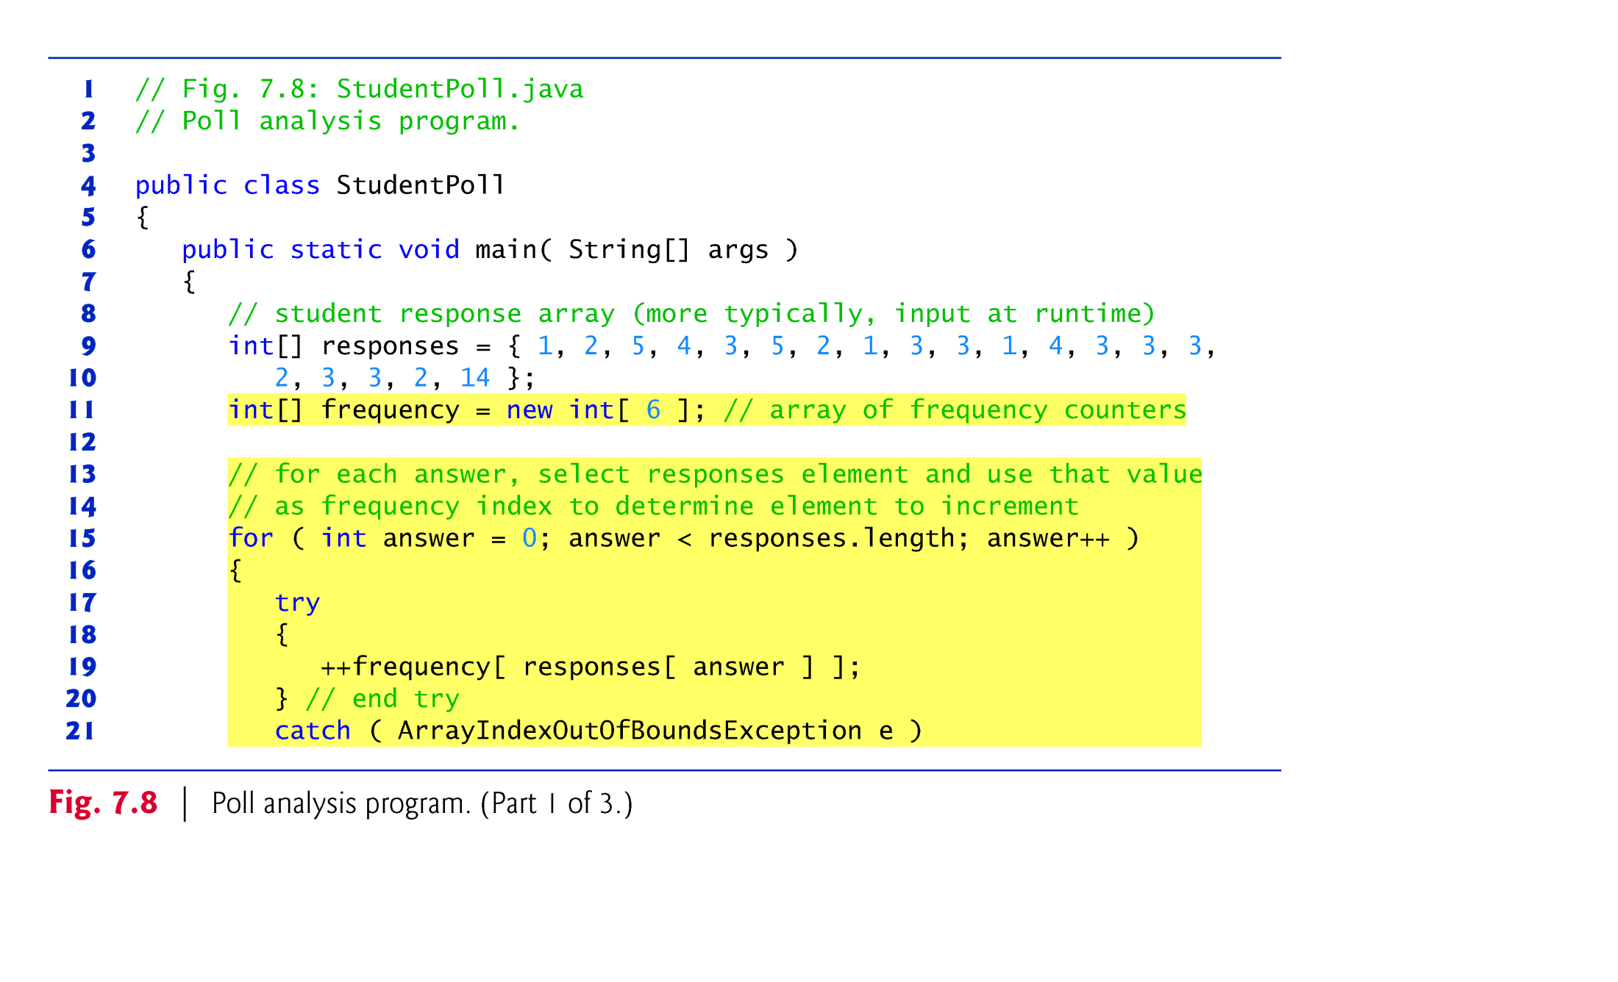

Slide 25
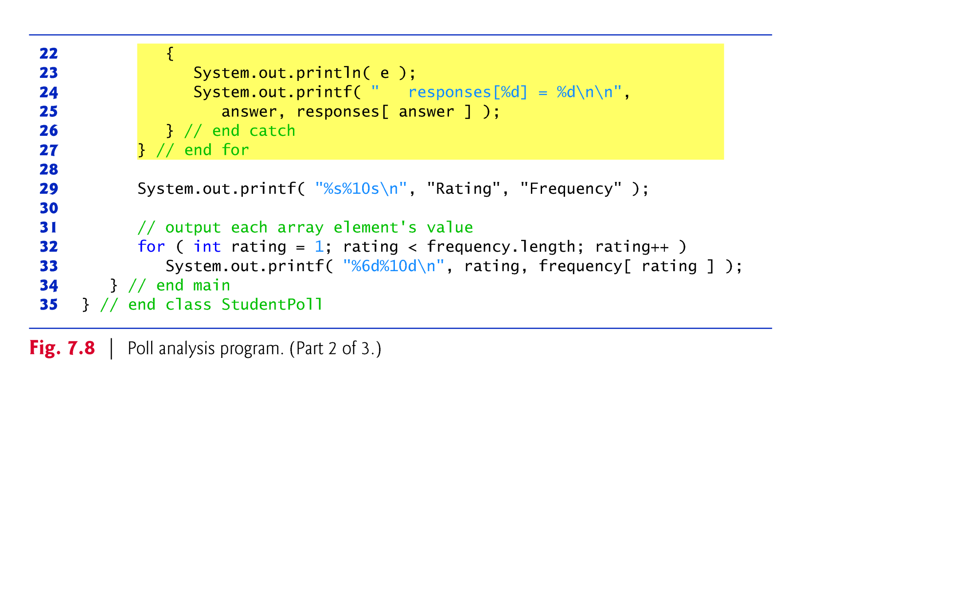

Slide 26
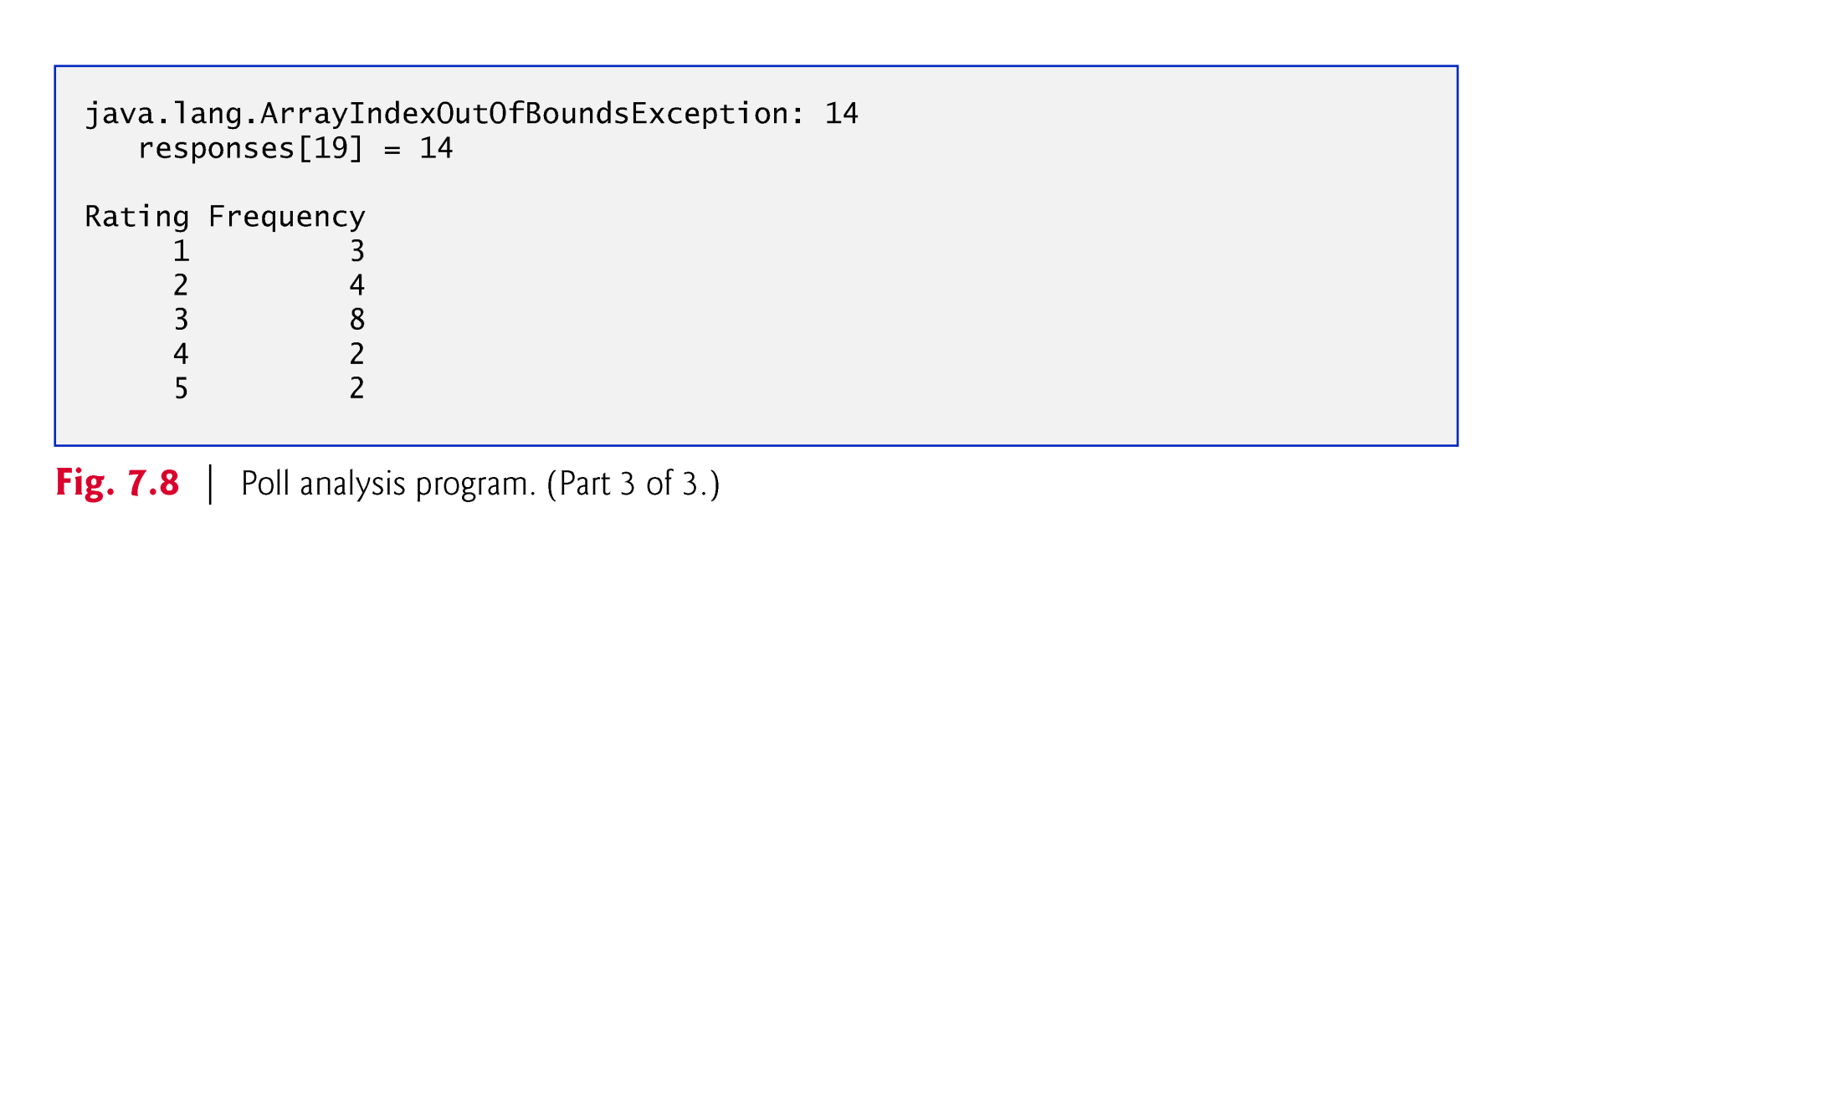

Slide 27
7.4 Examples Using Arrays (Cont.)
If a piece of data in the responses array is an invalid value, such as 14, the program attempts to add 1 to frequency[14], which is outside the bounds of the array.
Java doesn’t allow this.
JVM checks array indices to ensure that they are greater than or equal to 0 and less than the length of the array—this is called bounds checking.
If a program uses an invalid index, Java generates a so-called exception to indicate that an error occurred in the program at execution time.

Slide 28
7.4 Examples Using Arrays (Cont.)
An exception indicates a problem that occurs while a program executes.
The name “exception” suggests that the problem occurs infrequently—if the “rule” is that a statement normally executes correctly, then the problem represents the “exception to the rule.”
Exception handling enables you to create fault-tolerant programs that can resolve (or handle) exceptions.

Slide 29
7.4 Examples Using Arrays (Cont.)
When the JVM or a method detects a problem, such as an invalid array index or an invalid method argument, it throws an exception—that is, an exception occurs.
The try Statement
To handle an exception, place any code that might throw an exception in a try statement.
The try block contains the code that might throw an exception.
The catch block contains the code that handles the exception if one occurs. You can have many catch blocks to handle different types of exceptions that might be thrown in the corresponding try block.

Slide 30
7.4 Examples Using Arrays (Cont.)
Executing the catch Block
When the program encounters the value 14 in the responses array, it attempts to add 1 to frequency[14], which is outside the bounds of the array—the frequency array has only six elements.
Because array bounds checking is performed at execution time, the JVM generates an exception—specifically line 19 throws an ArrayIndexOutOfBoundsException to notify the program of this problem.
At this point the try block terminates and the catch block begins executing—if you declared any variables in the try block, they’re now out of scope.

Slide 31
7.4 Examples Using Arrays (Cont.)
The catch block declares a type and an exception parameter, and can handle exceptions of the specified type.
Inside the catch block, you can use the parameter’s identifier to interact with a caught exception object.
The exception object’s toString method returns the error message that is stored in the exception object.
The exception is considered handled when program control reaches the closing right brace of the catch block.

Slide 32
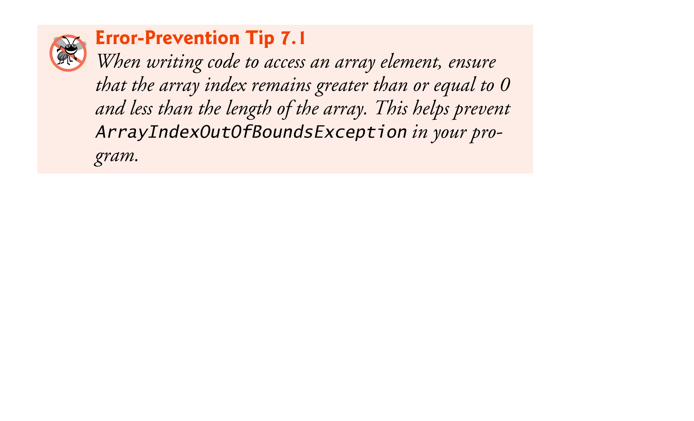

Slide 33
7.5 Case Study: Card Shuffling and Dealing Simulation
Examples thus far used arrays containing elements of primitive types.
Elements of an array can be either primitive types or reference types.
Next example uses an array of reference-type elements—objects representing playing cards—to develop a class that simulates card shuffling and dealing.

Slide 34
7.5 Case Study: Card Shuffling and Dealing Simulation (Cont.)
Class Card (Fig. 7.9) contains two String instance variables—face and suit—that are used to store references to the face and suit names for a specific Card.
Method toString creates a String consisting of the face of the card, " of " and the suit of the card.
Can invoke explicitly to obtain a string representation of a Card.
Called implicitly when the object is used where a String is expected.

Slide 35
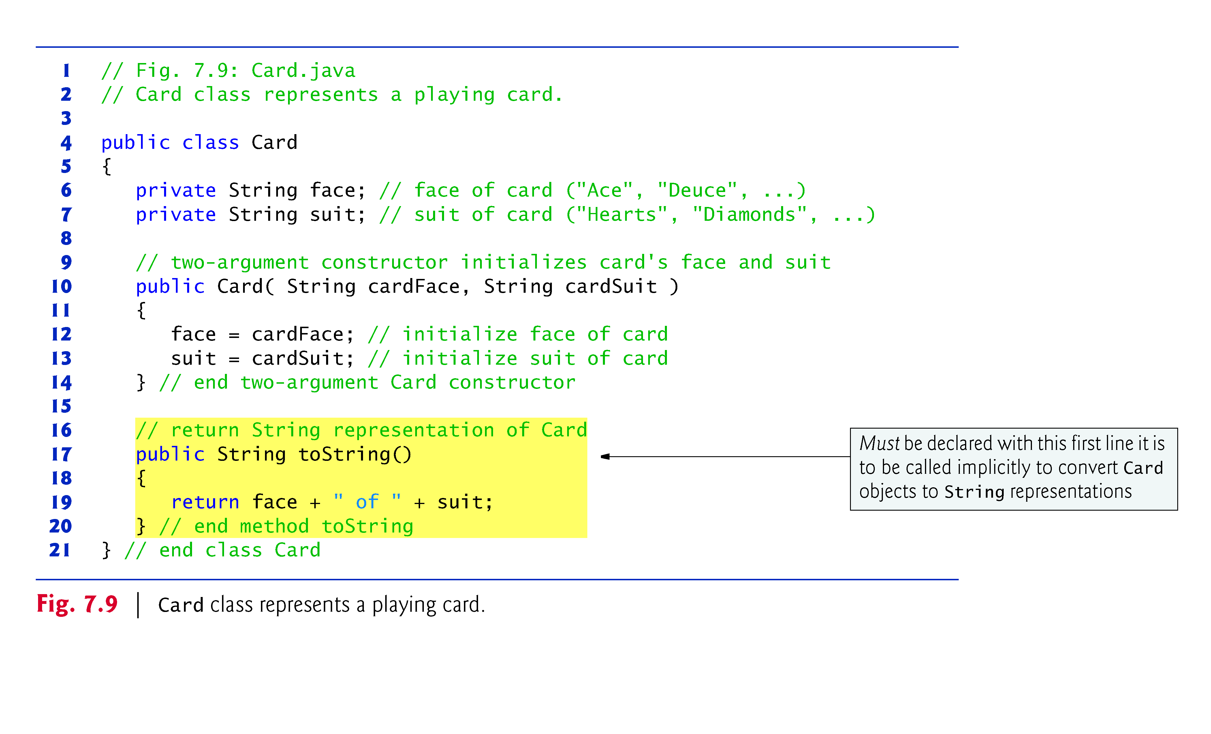

Slide 36
7.5 Case Study: Card Shuffling and Dealing Simulation (Cont.)
Class DeckOfCards (Fig. 7.10) declares as an instance variable a Card array named deck.
Deck’s elements are null by default
Constructor fills the deck array with Card objects.
Method shuffle shuffles the Cards in the deck.
Loops through all 52 Cards (array indices 0 to 51).
Each Card swapped with a randomly chosen other card in the deck.
Method dealCard deals one Card in the array.
currentCard indicates the index of the next Card to be dealt
Returns null if there are no more cards to deal

Slide 37
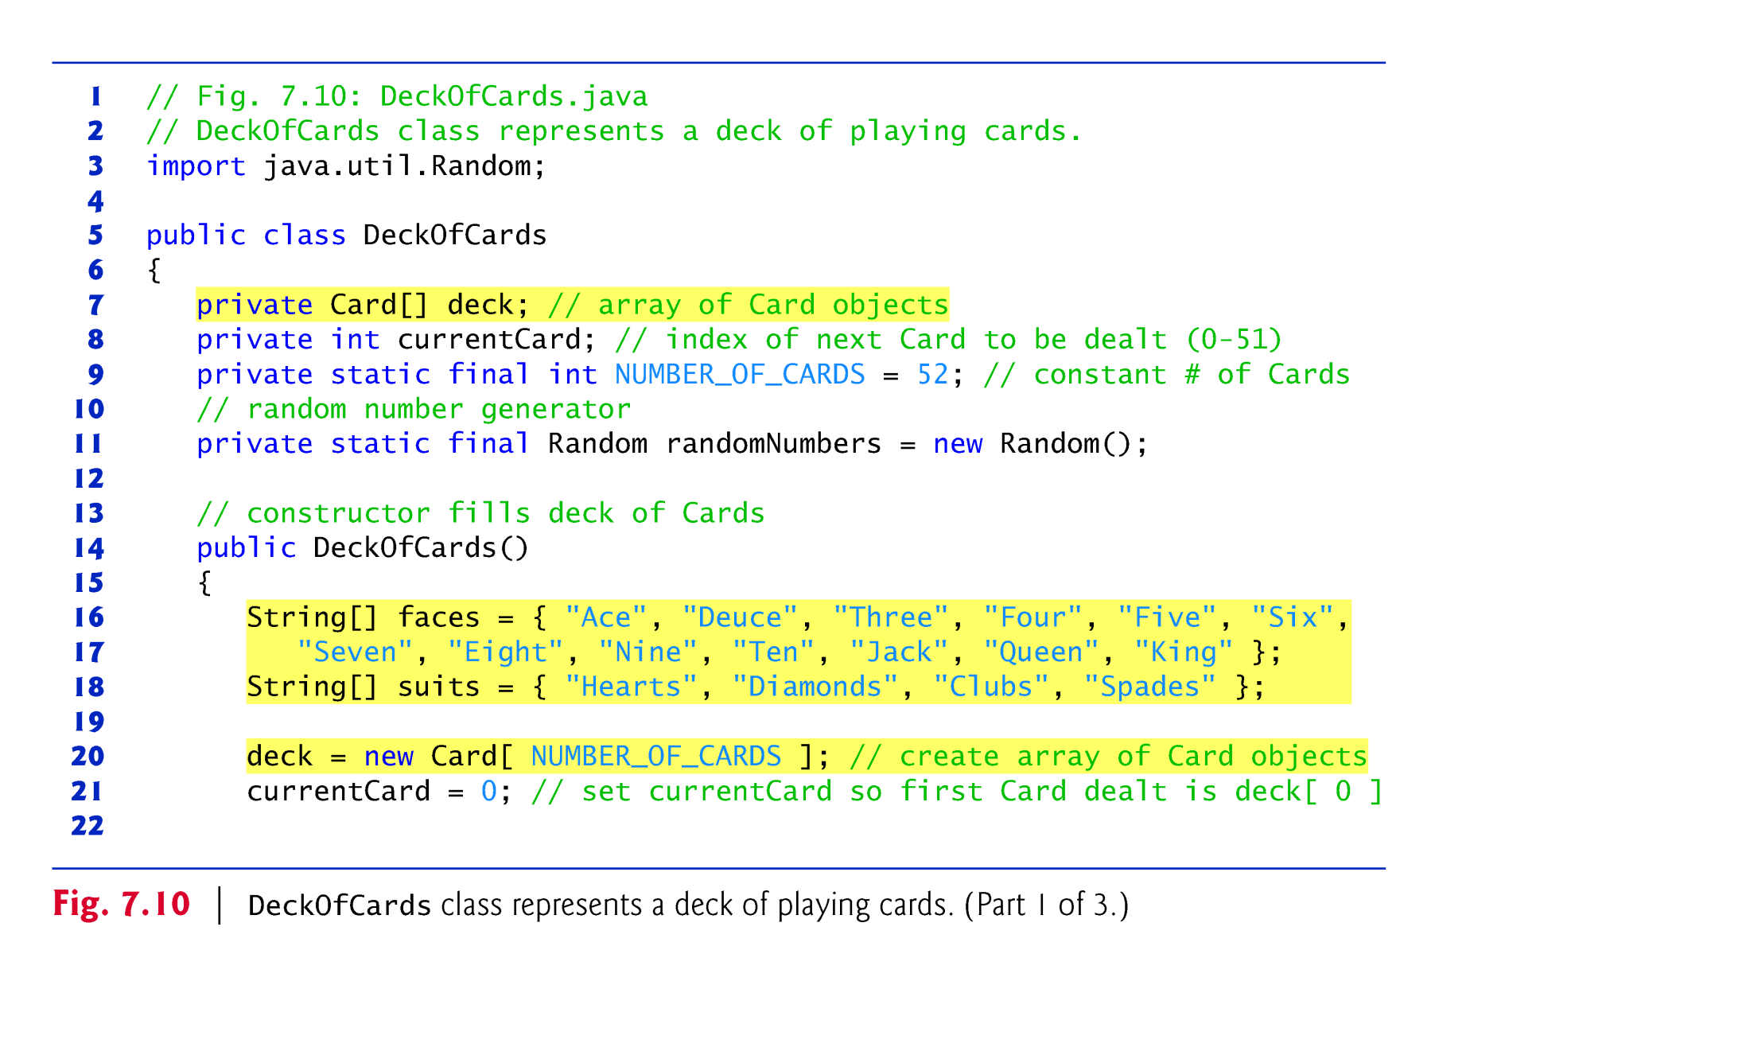

Slide 38
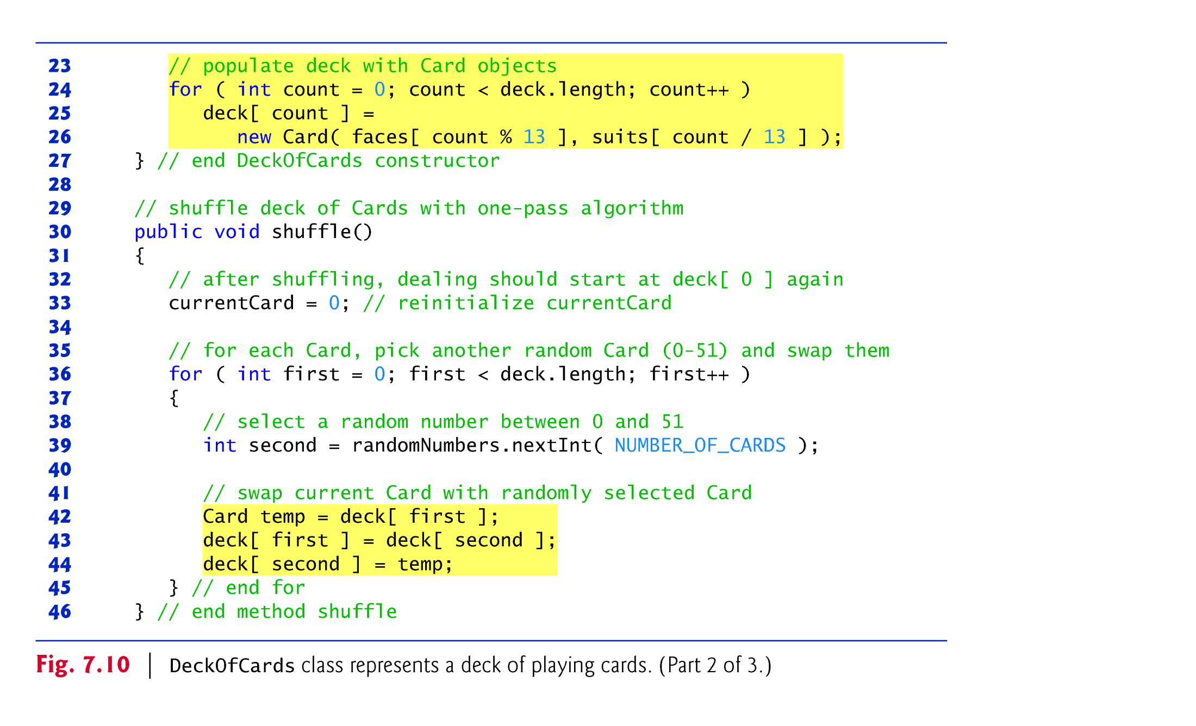

Slide 39
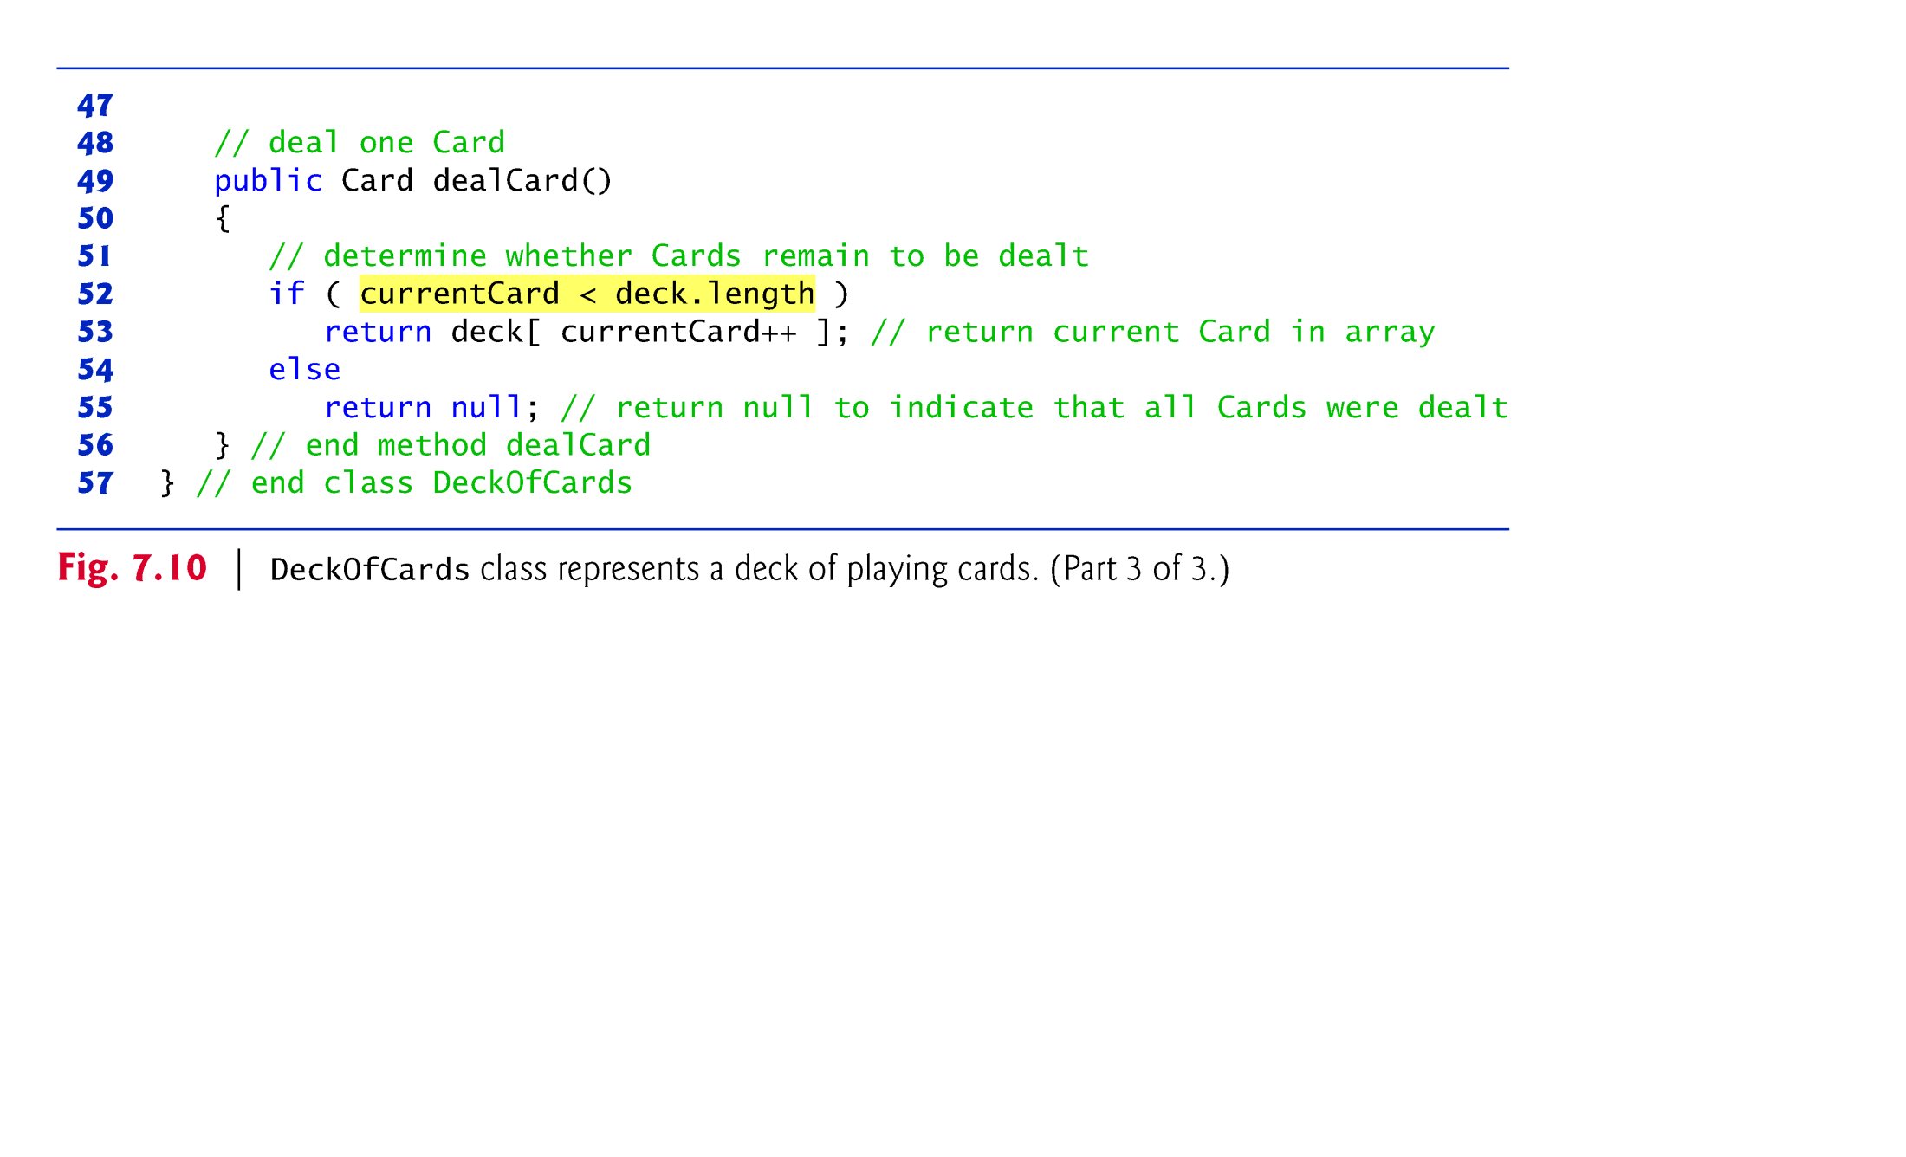

Slide 40
7.5 Case Study: Card Shuffling and Dealing Simulation (Cont.)
Figure 7.11 demonstrates class DeckOfCards (Fig. 7.10).
When a Card is output as a String, the Card’s toString method is implicitly invoked.

Slide 41
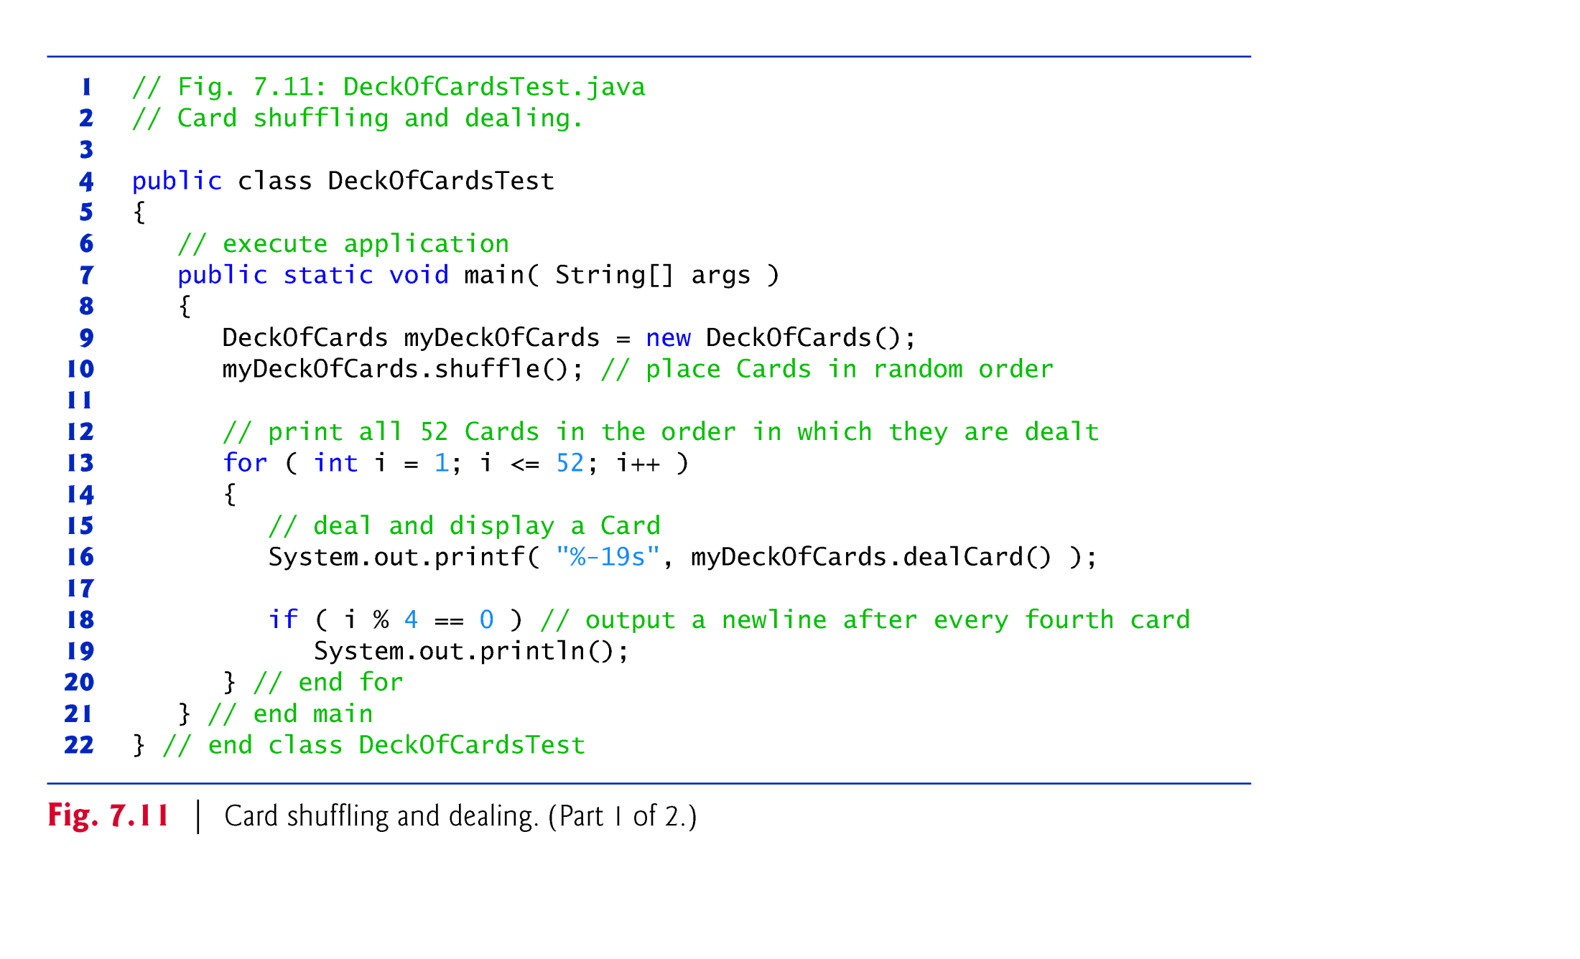

Slide 42
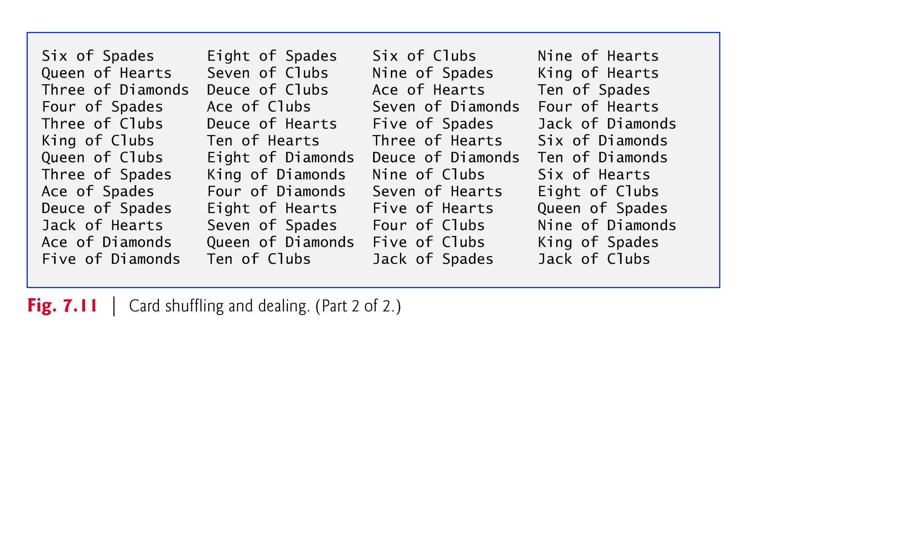

Slide 43
7.6 Enhanced for Statement
Enhanced for statement
Iterates through the elements of an array without using a counter.
Avoids the possibility of “stepping outside” the array.
Also works with the Java API’s prebuilt collections (see Section 7.14).
Syntax:
for ( parameter : arrayName ) statement
where parameter has a type and an identifier and arrayName is the array through which to iterate.
Parameter type must be consistent with the array’s element type.
The enhanced for statement simplifies the code for iterating through an array.

Slide 44
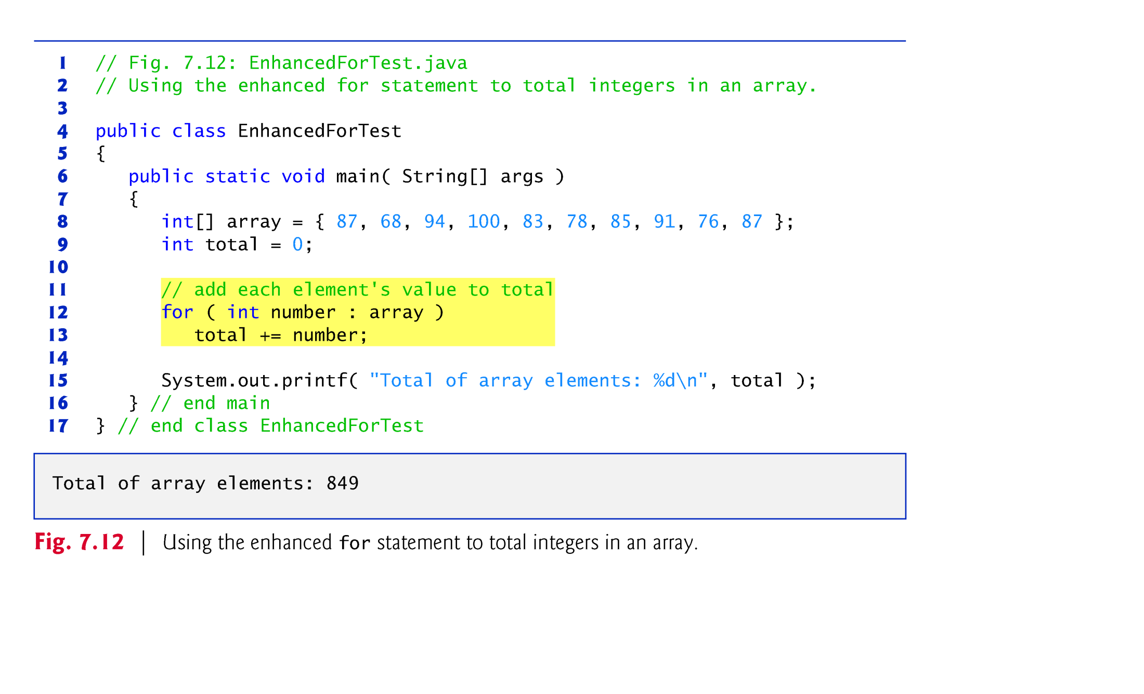

Slide 45
7.6 Enhanced for Statement (Cont.)
The enhanced for statement can be used only to obtain array elements
It cannot be used to modify elements.
To modify elements, use the traditional counter-controlled for statement.
Can be used in place of the counter-controlled for statement if you don’t need to access the index of the element.

Slide 46
7.7 Passing Arrays to Methods
To pass an array argument to a method, specify the name of the array without any brackets.
Since every array object “knows” its own length, we need not pass the array length as an additional argument.
To receive an array, the method’s parameter list must specify an array parameter.
When an argument to a method is an entire array or an individual array element of a reference type, the called method receives a copy of the reference.
When an argument to a method is an individual array element of a primitive type, the called method receives a copy of the element’s value.

Slide 47
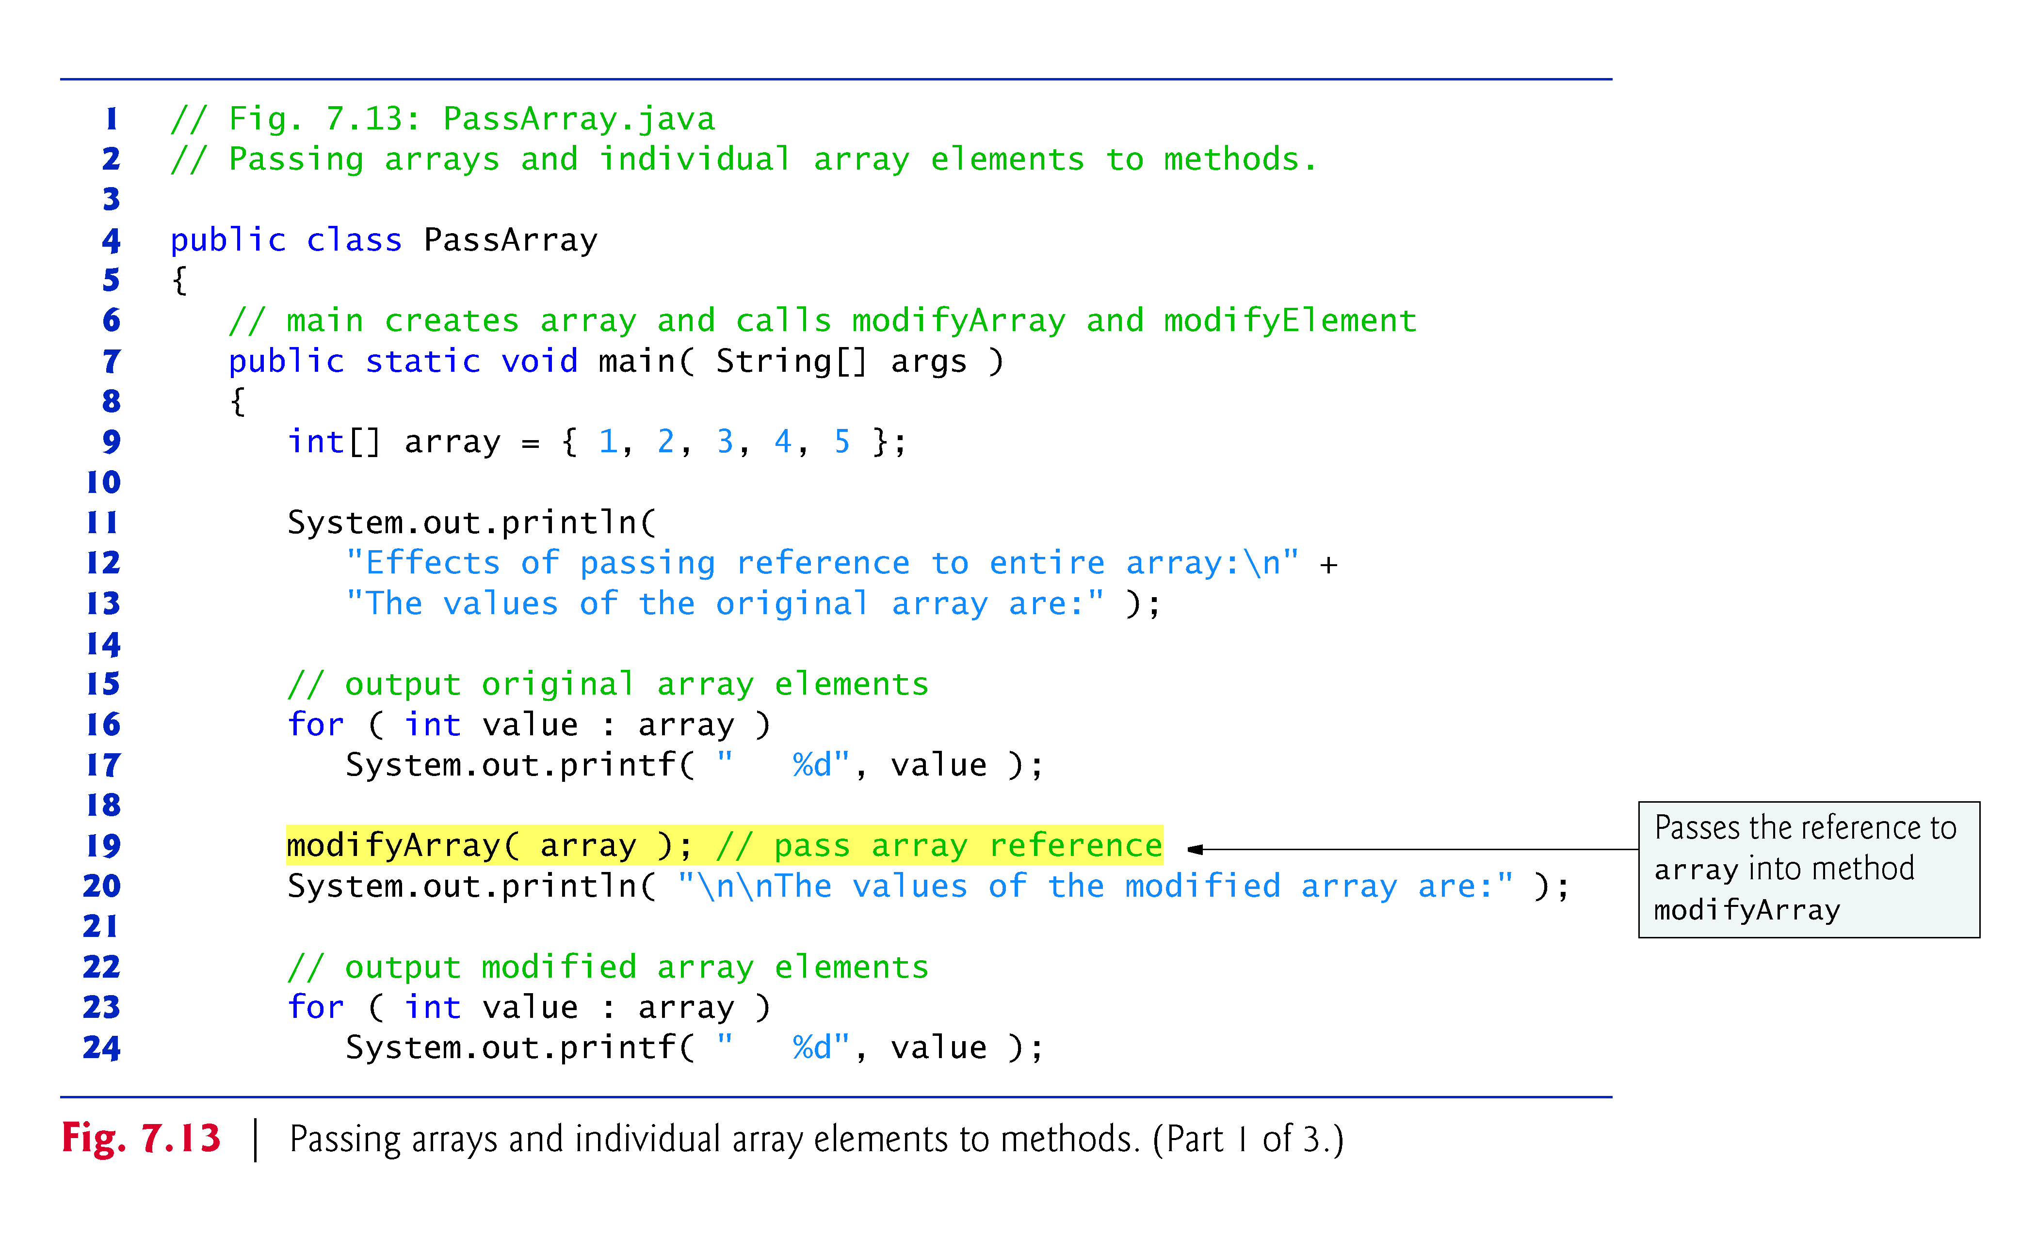

Slide 48
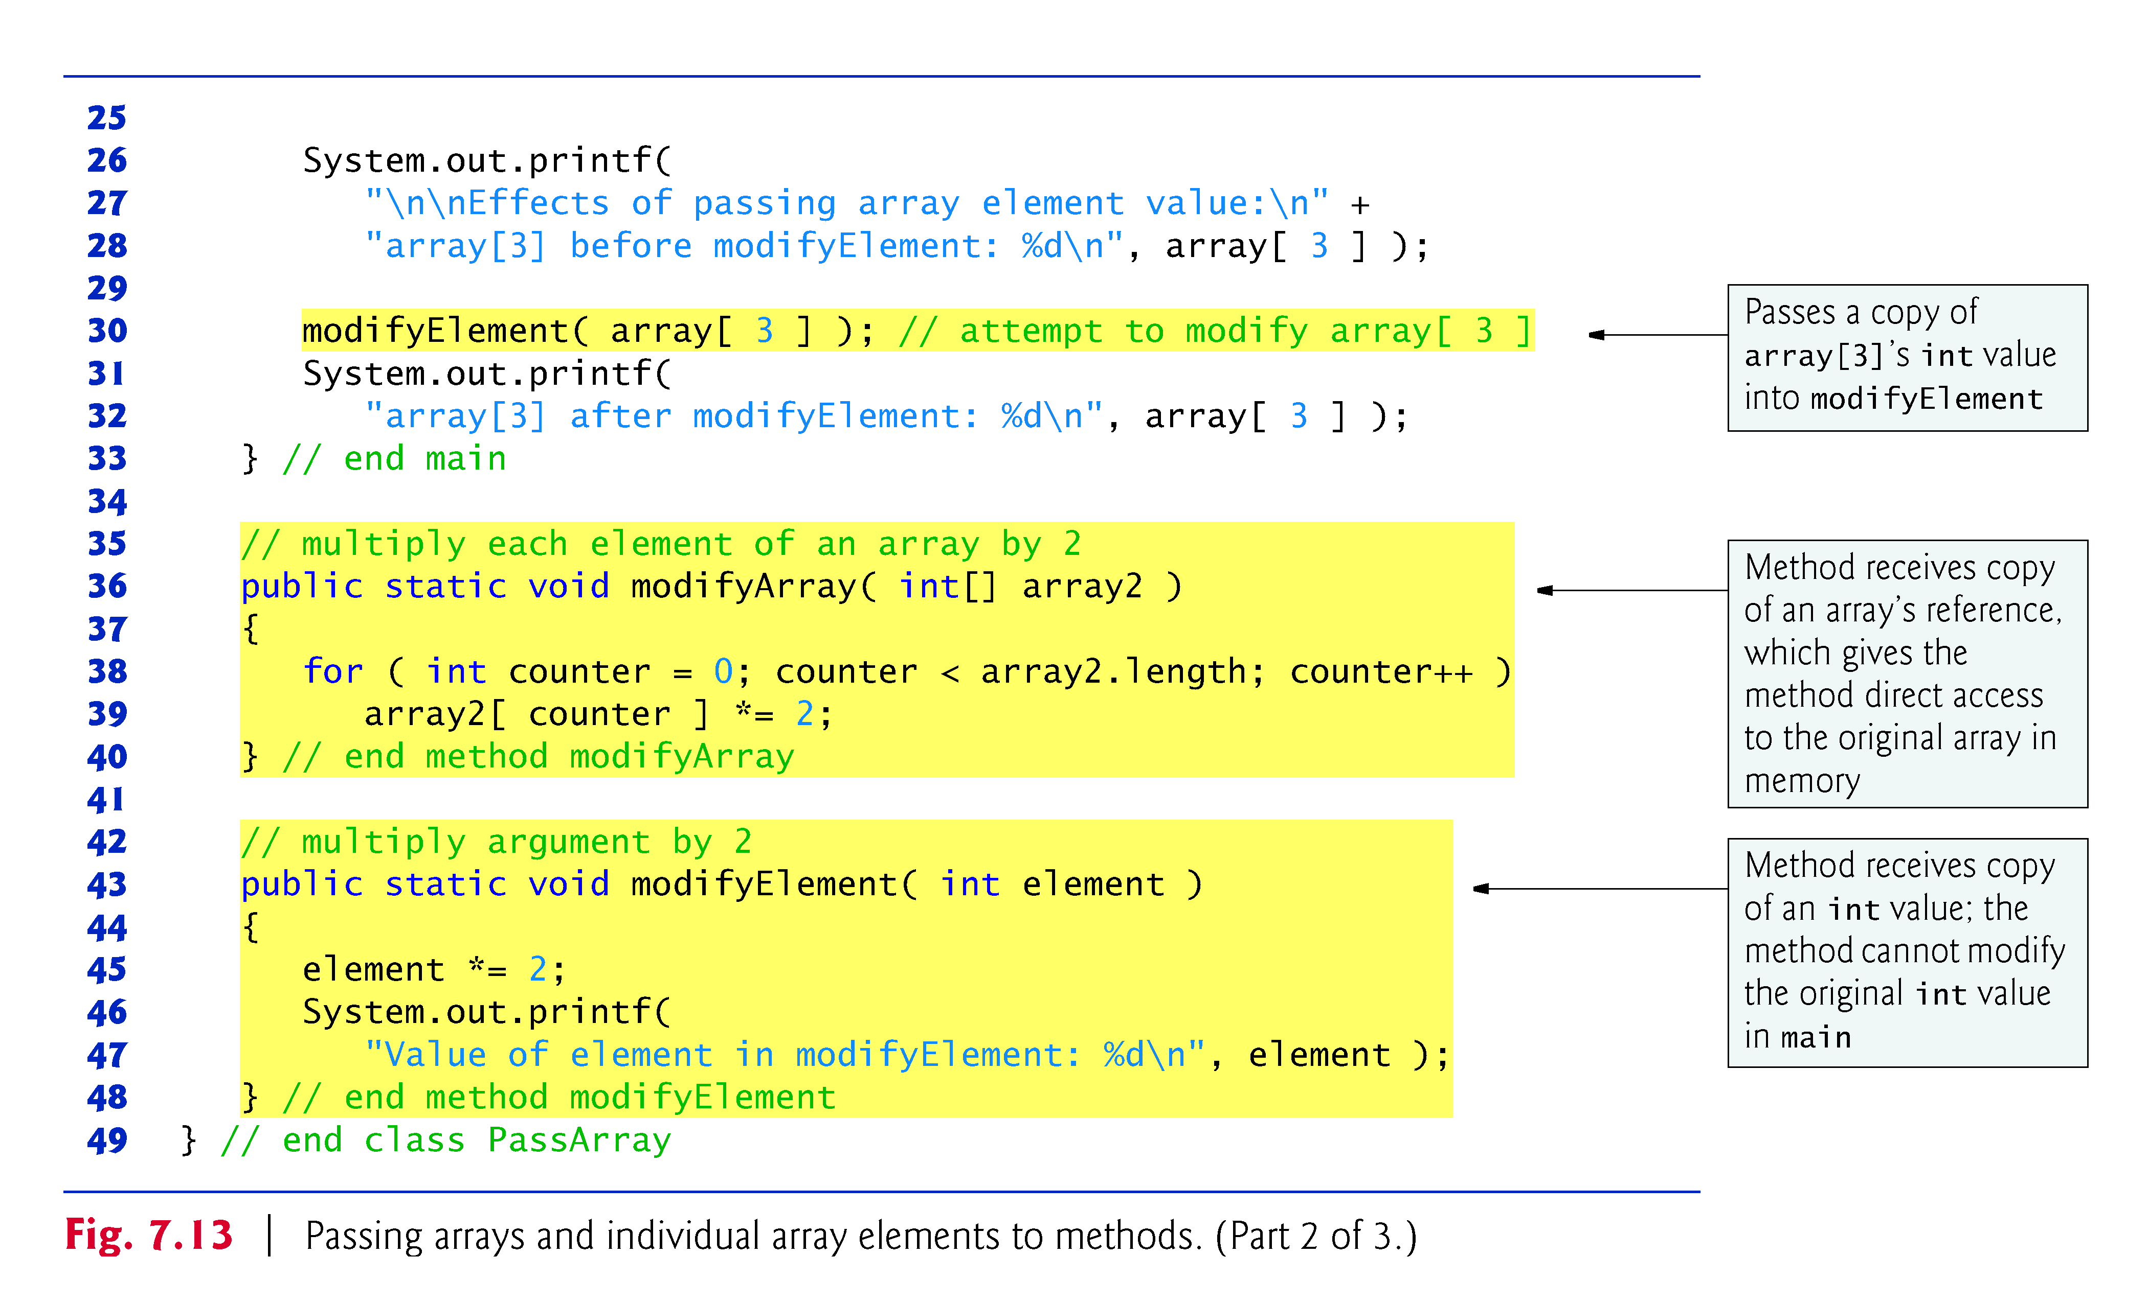

Slide 49
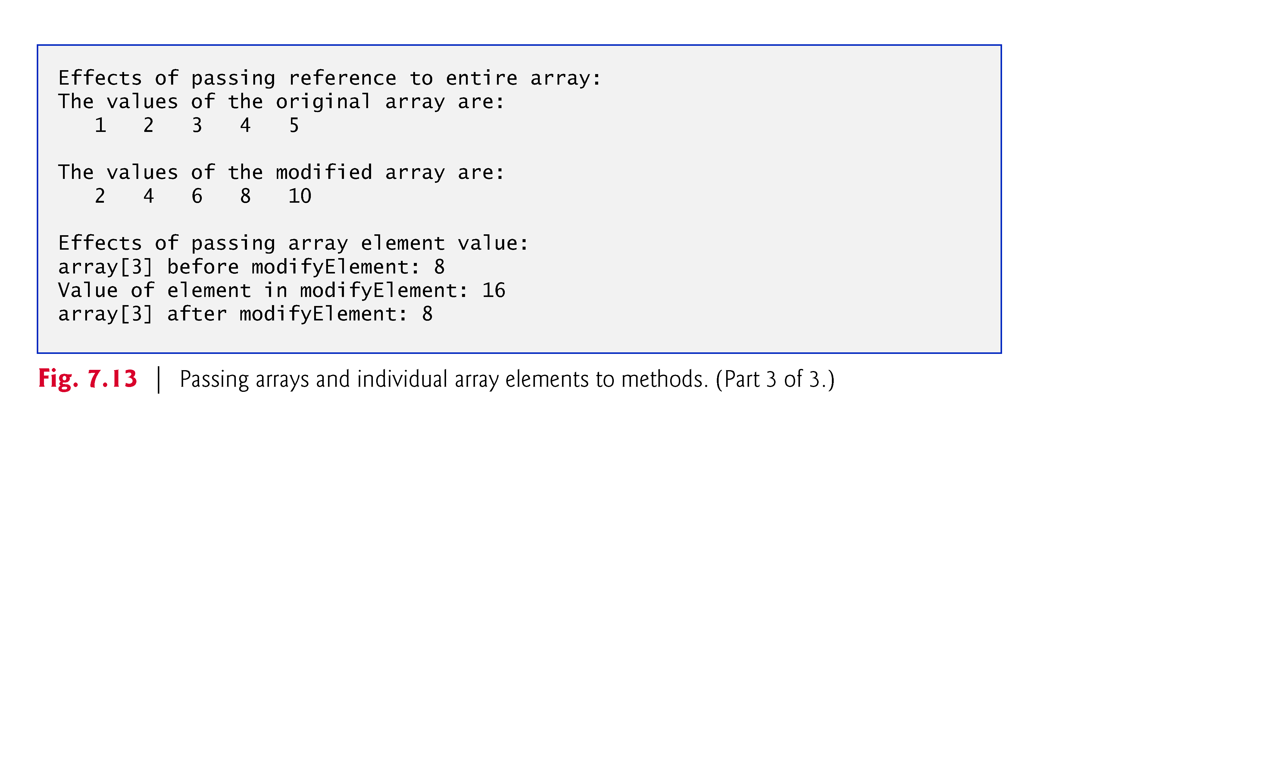

Slide 50
7.7 Passing Arrays to Methods (Cont.)
Pass-by-value (also called call-by-value)
A copy of the argument’s value is passed to the called method.
The called method works exclusively with the copy.
Changes to the called method’s copy do not affect the original variable’s value in the caller.
Pass-by-reference (also called call-by-reference)
The called method can access the argument’s value in the caller directly and modify that data, if necessary.
Improves performance by eliminating the need to copy possibly large amounts of data.

Slide 51
7.7 Passing Arrays to Methods (Cont.)
All arguments in Java are passed by value.
A method call can pass two types of values to a method
Copies of primitive values
Copies of references to objects
Objects cannot be passed to methods.
If a method modifies a reference-type parameter so that it refers to another object, only the parameter refers to the new object
The reference stored in the caller’s variable still refers to the original object.
Although an object’s reference is passed by value, a method can still interact with the referenced object by calling its public methods using the copy of the object’s reference.
The parameter in the called method and the argument in the calling method refer to the same object in memory.

Slide 52
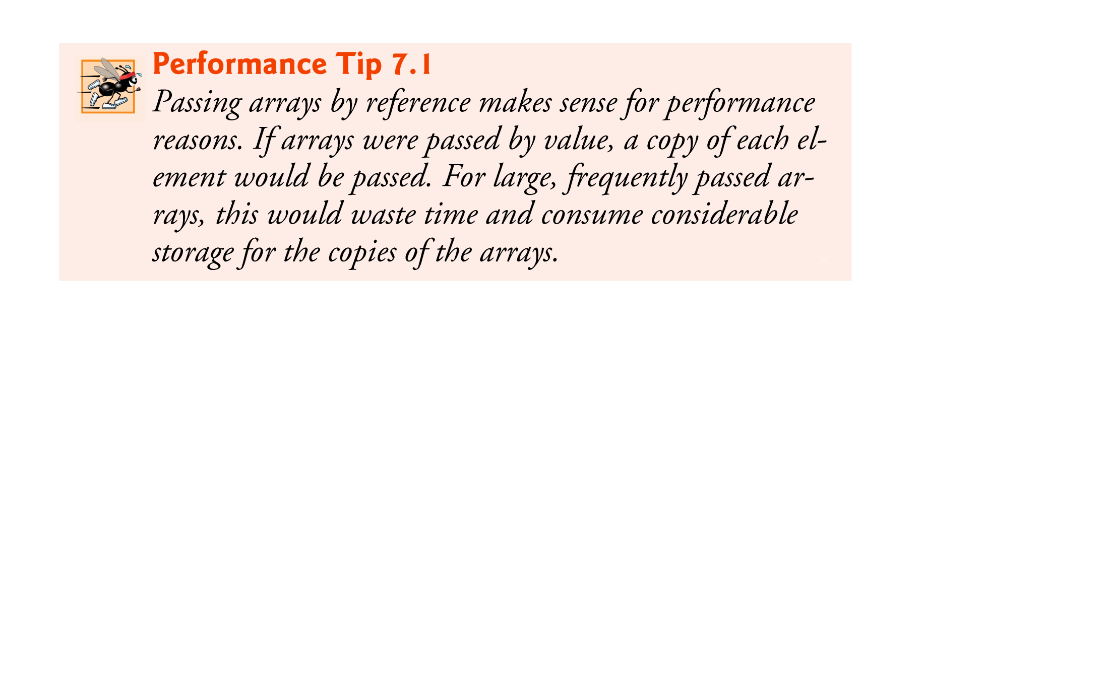

Slide 53
7.8 Case Study: Class GradeBook Using an Array to Store Grades
Previous versions of class GradeBook process a set of grades entered by the user, but do not maintain the individual grade values in instance variables of the class.
Repeat calculations require the user to reenter the same grades.
We solve this problem by storing grades in an array.
The grades array’s size is determined by the length of the array that is passed to the constructor.
So a GradeBook object can process a variable number of grades.

Slide 54
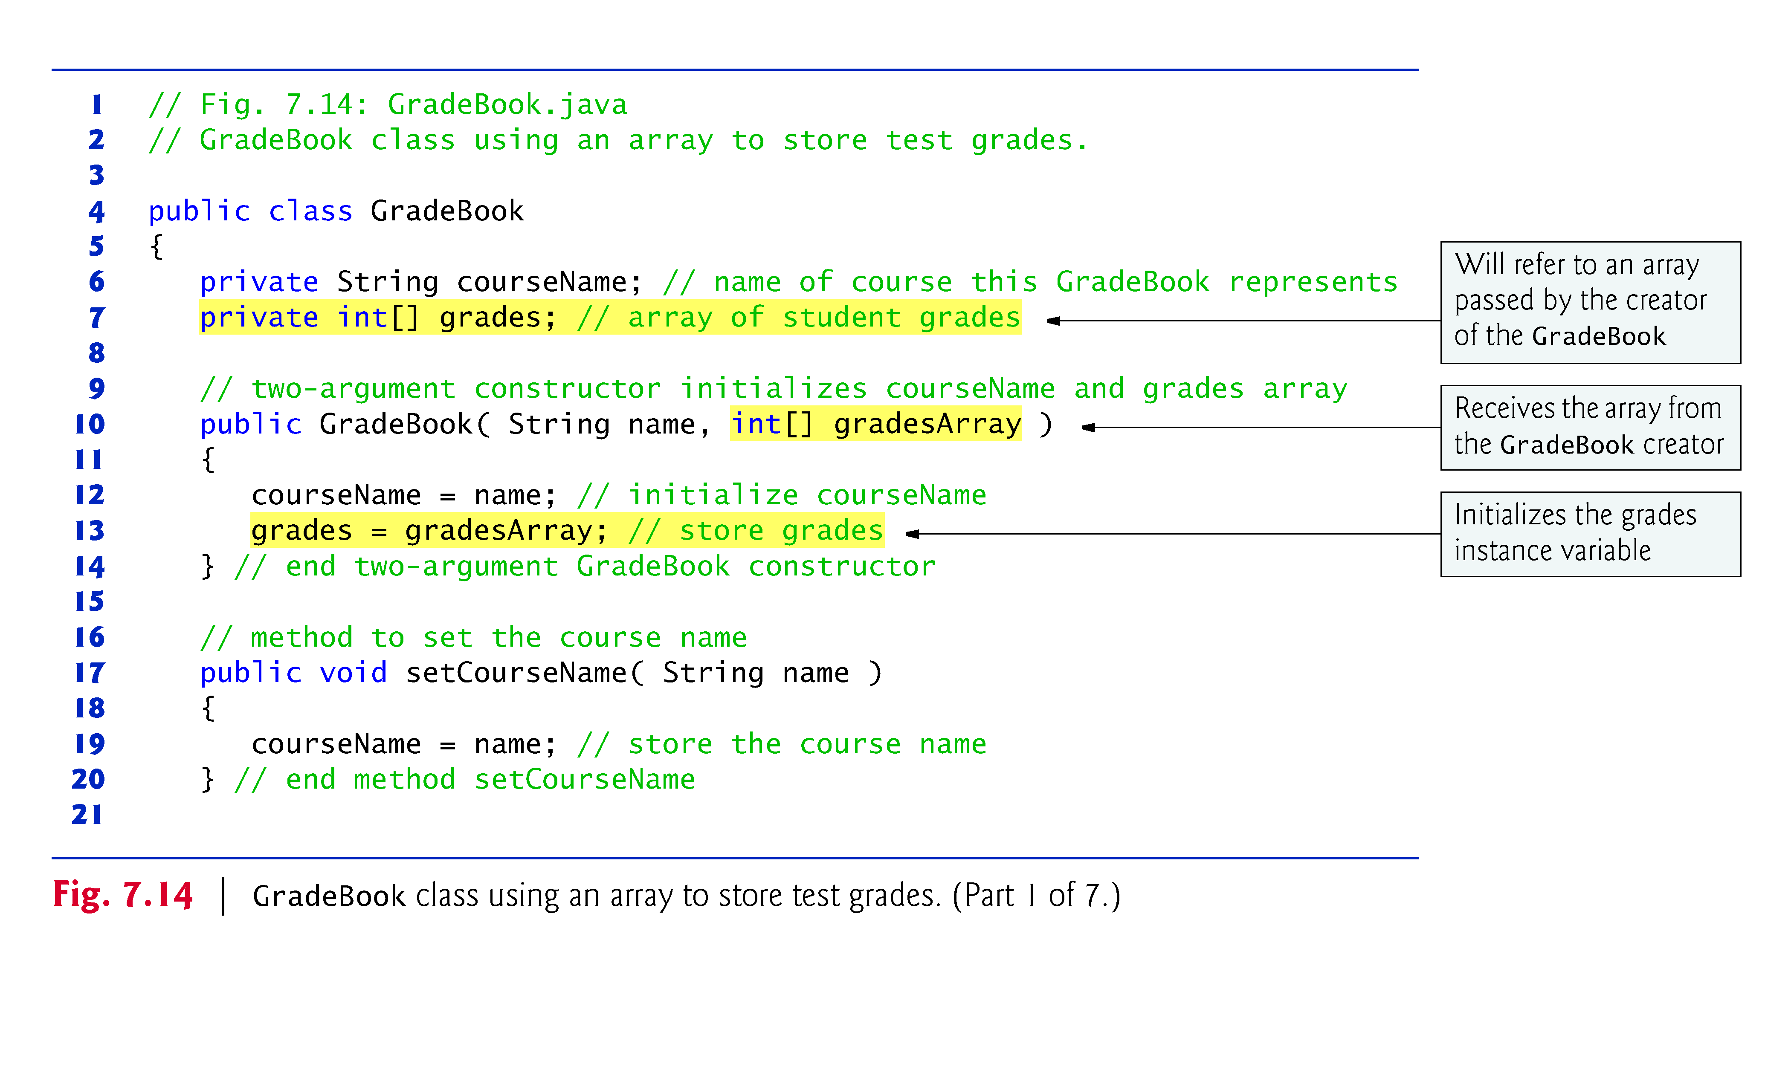

Slide 55
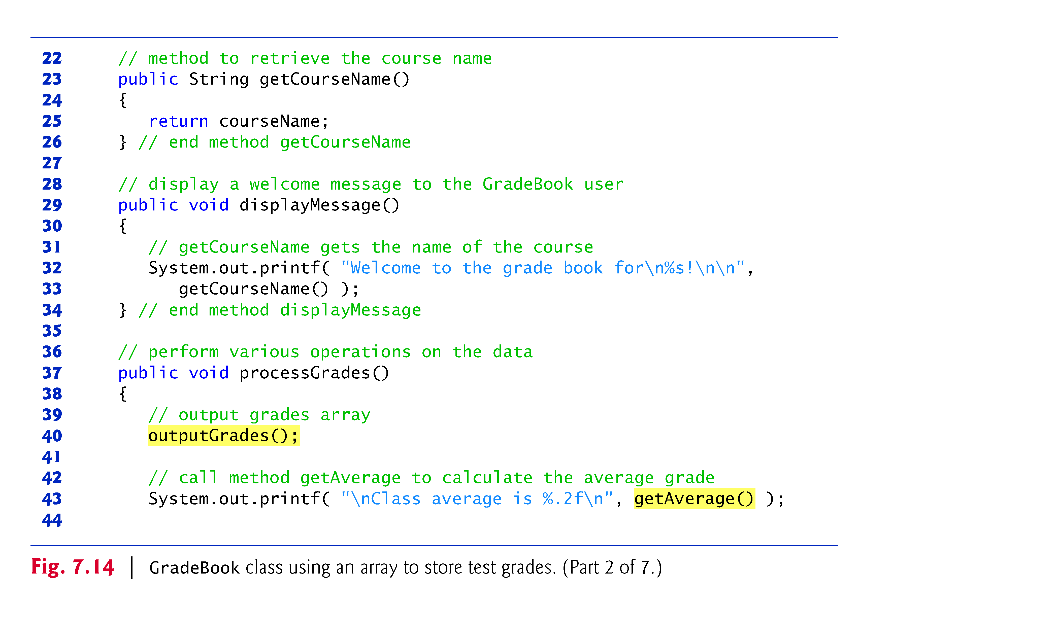

Slide 56
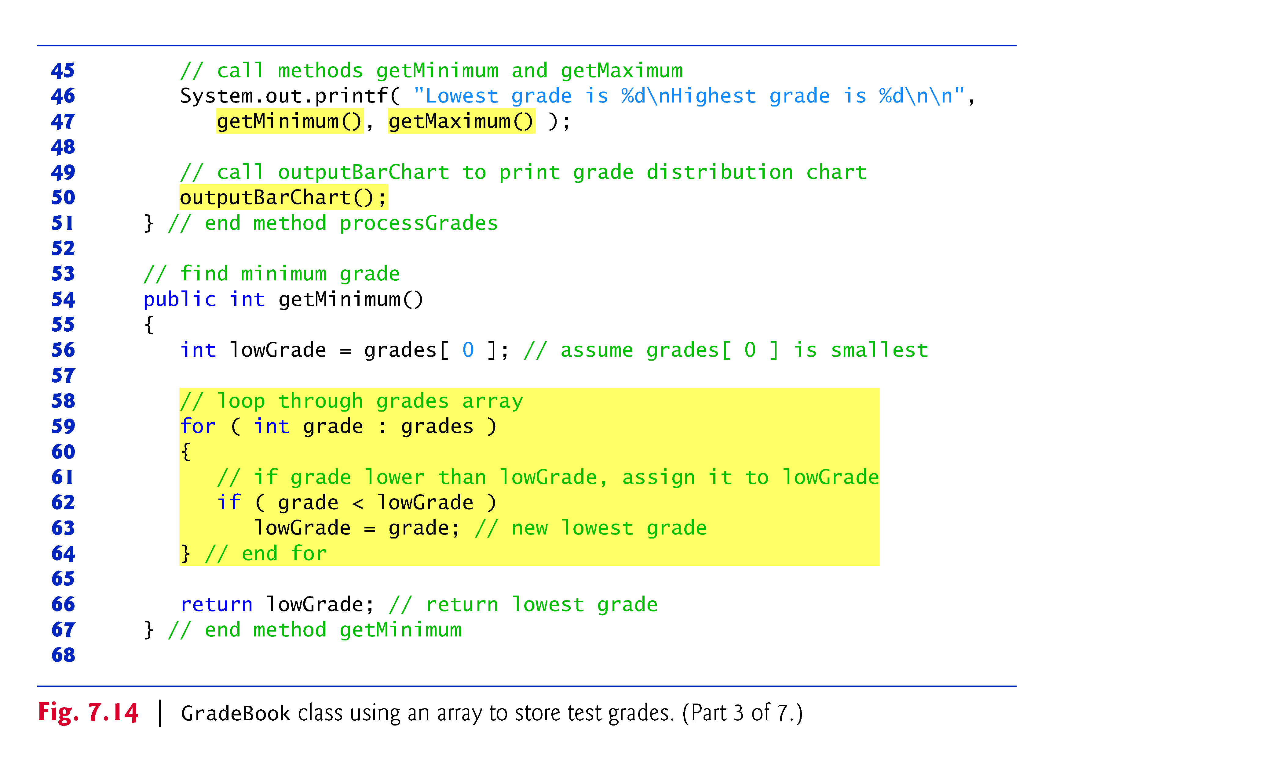

Slide 57
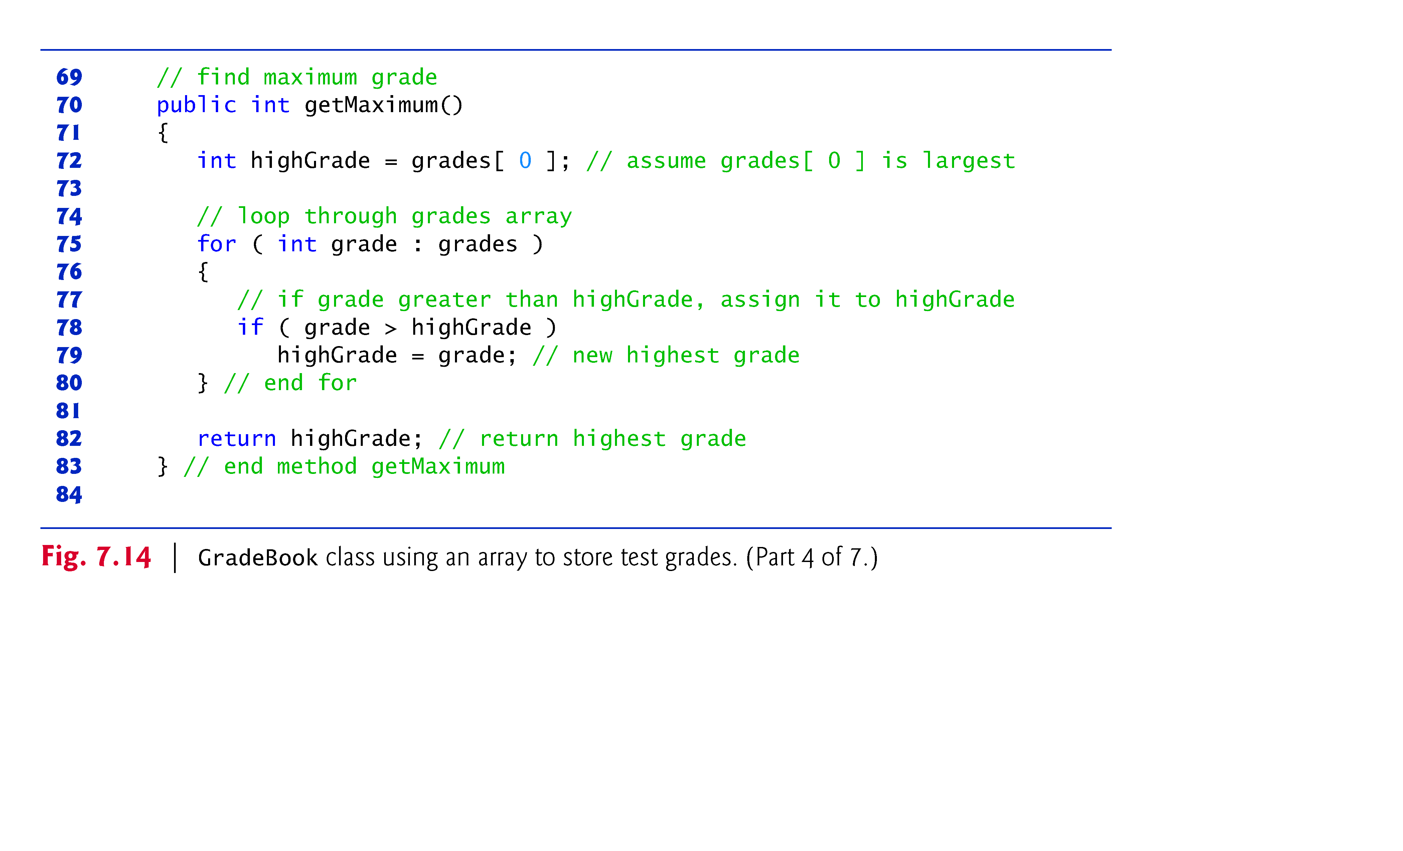

Slide 58
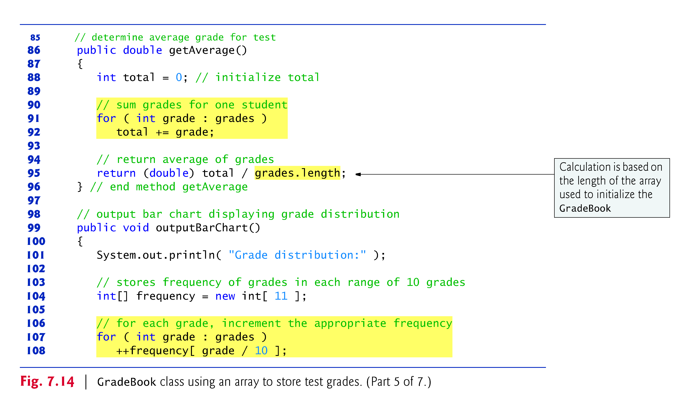

Slide 59
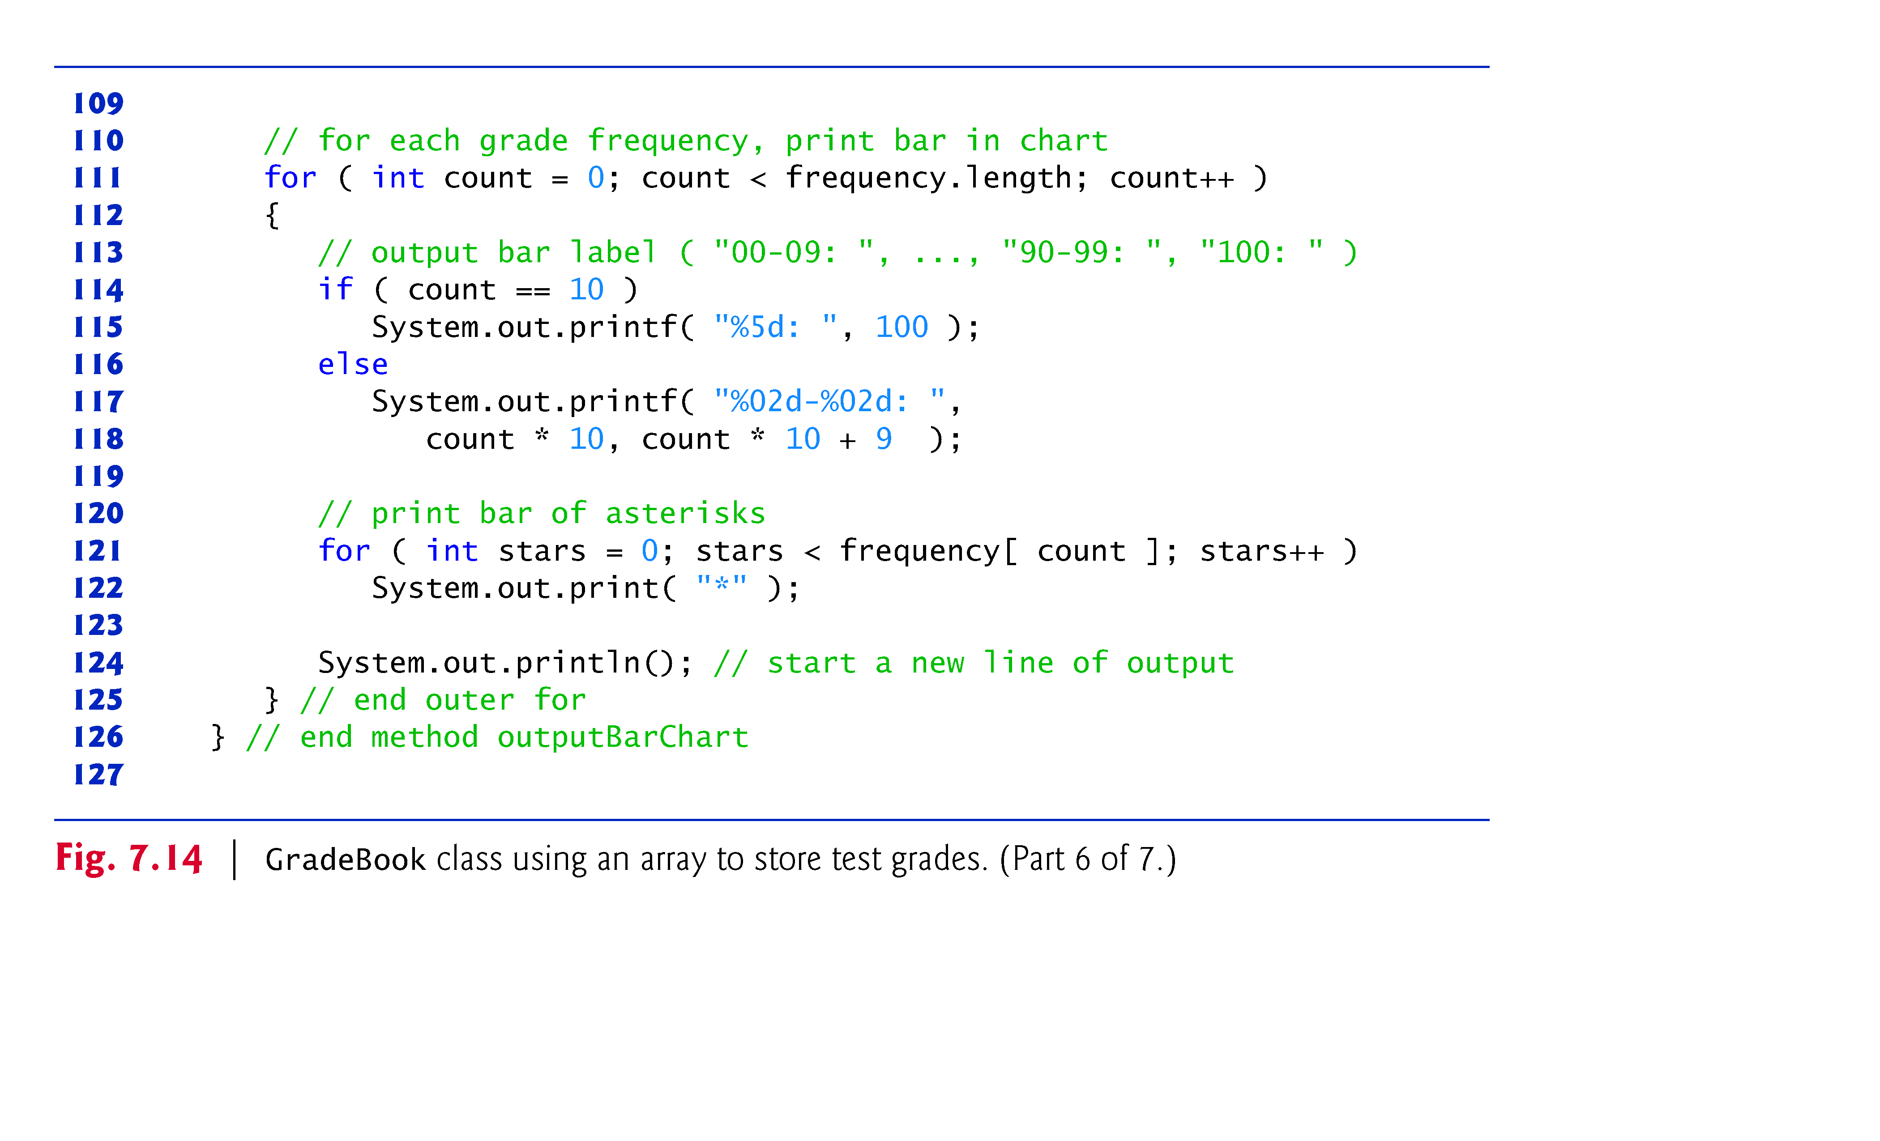

Slide 60
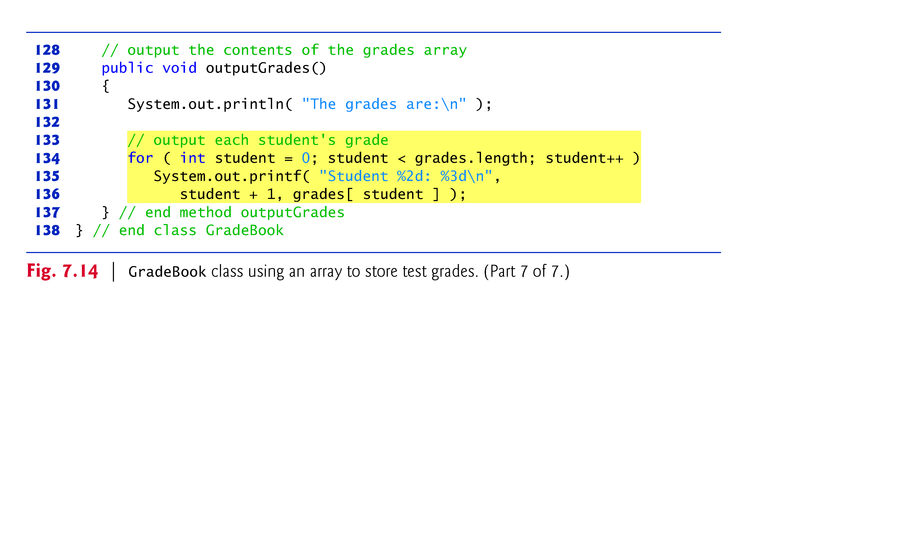

Slide 61
7.8 Case Study: Class GradeBook Using an Array to Store Grades (Cont.)
The application of Fig. 7.15 creates an object of class GradeBook (Fig. 7.14) using the int array grades-Array.
Lines 12–13 pass a course name and gradesArray to the GradeBook constructor.

Slide 62
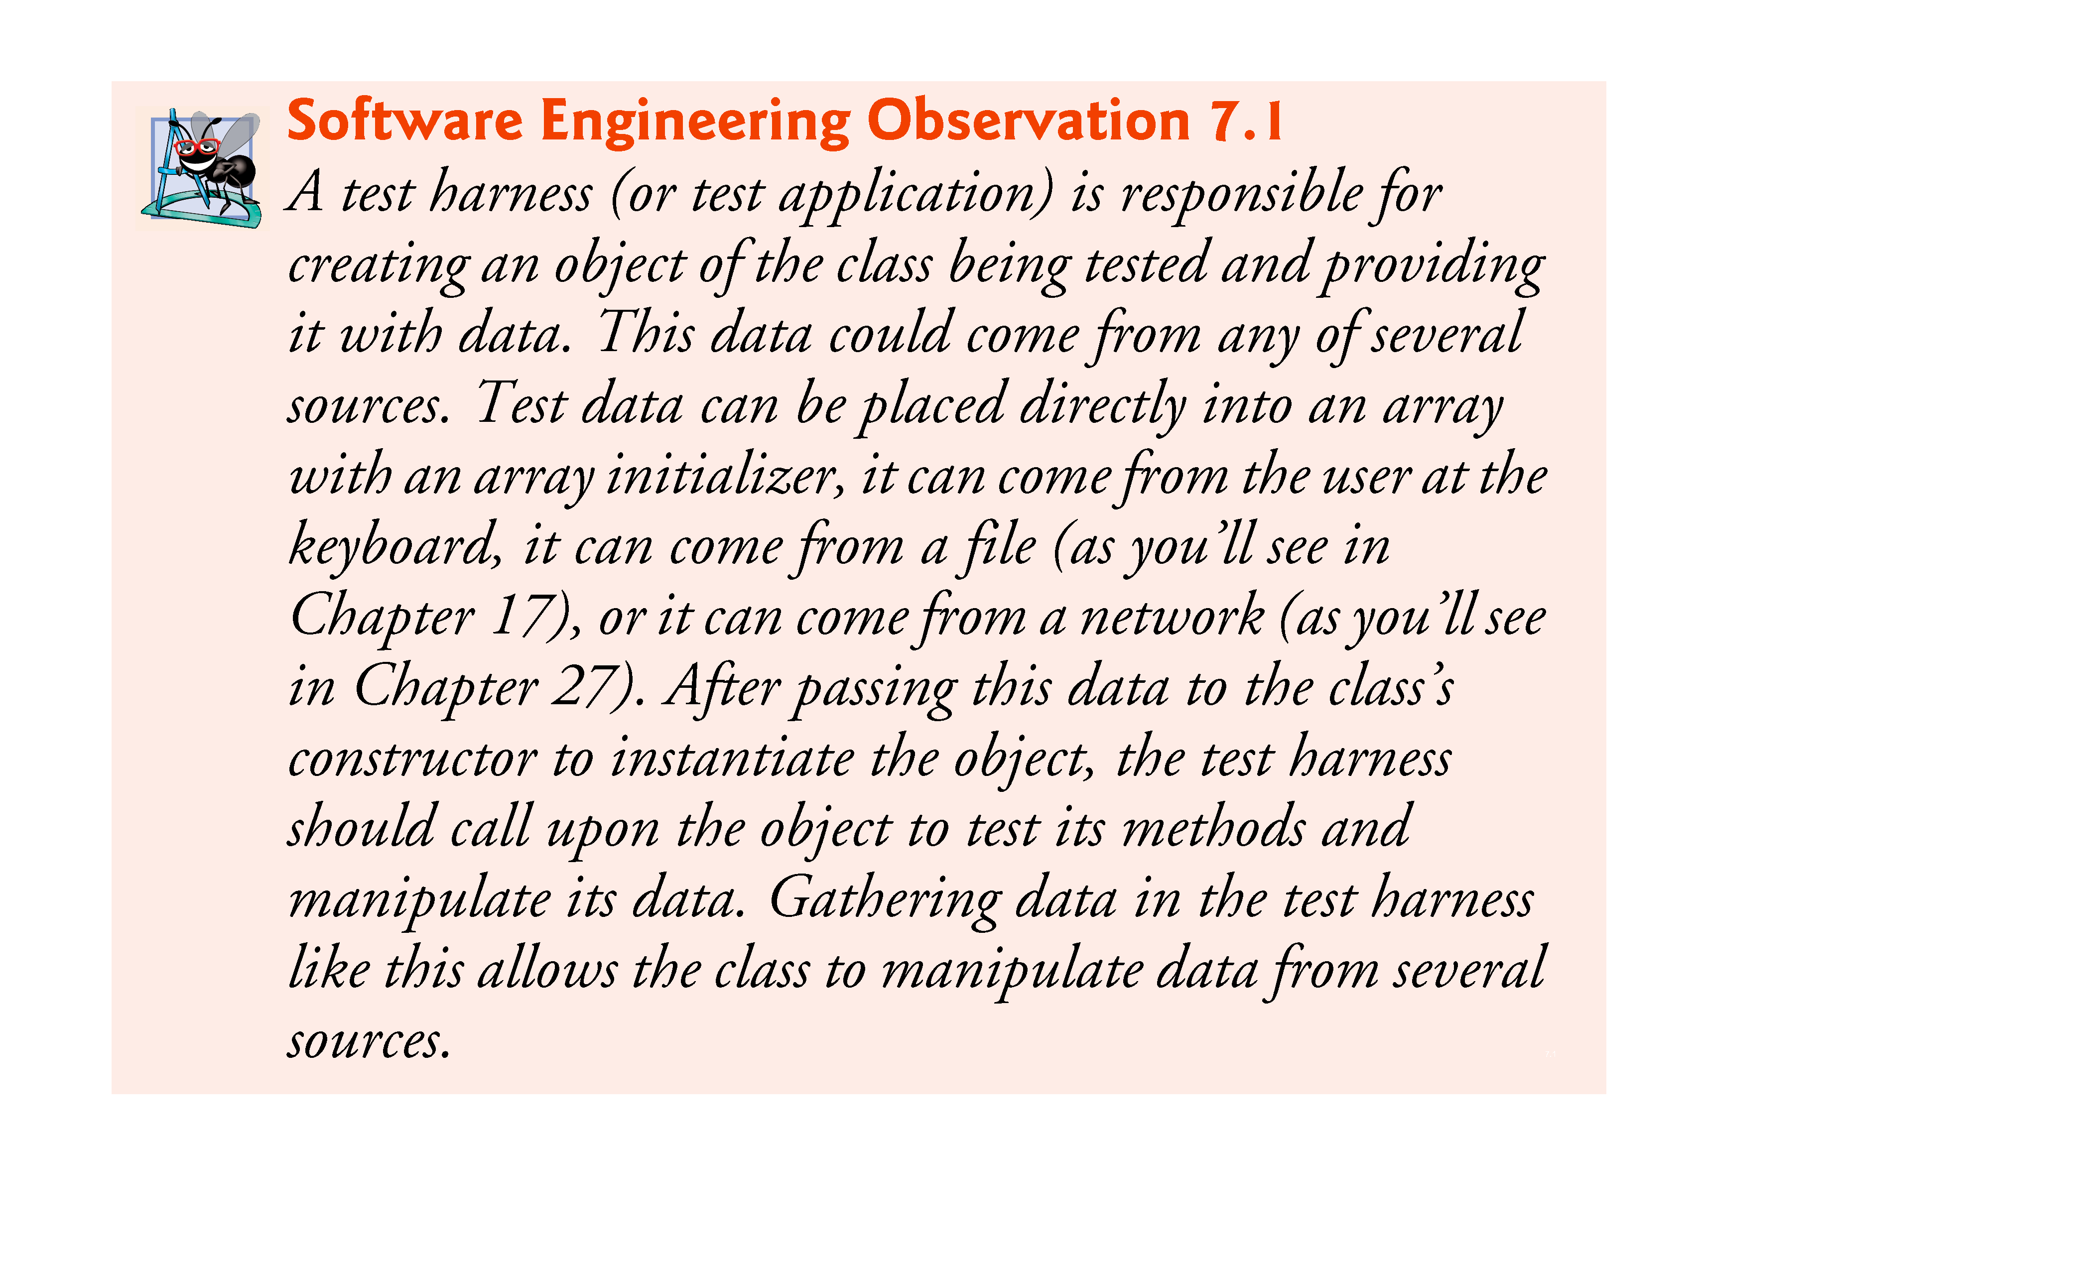

Slide 63
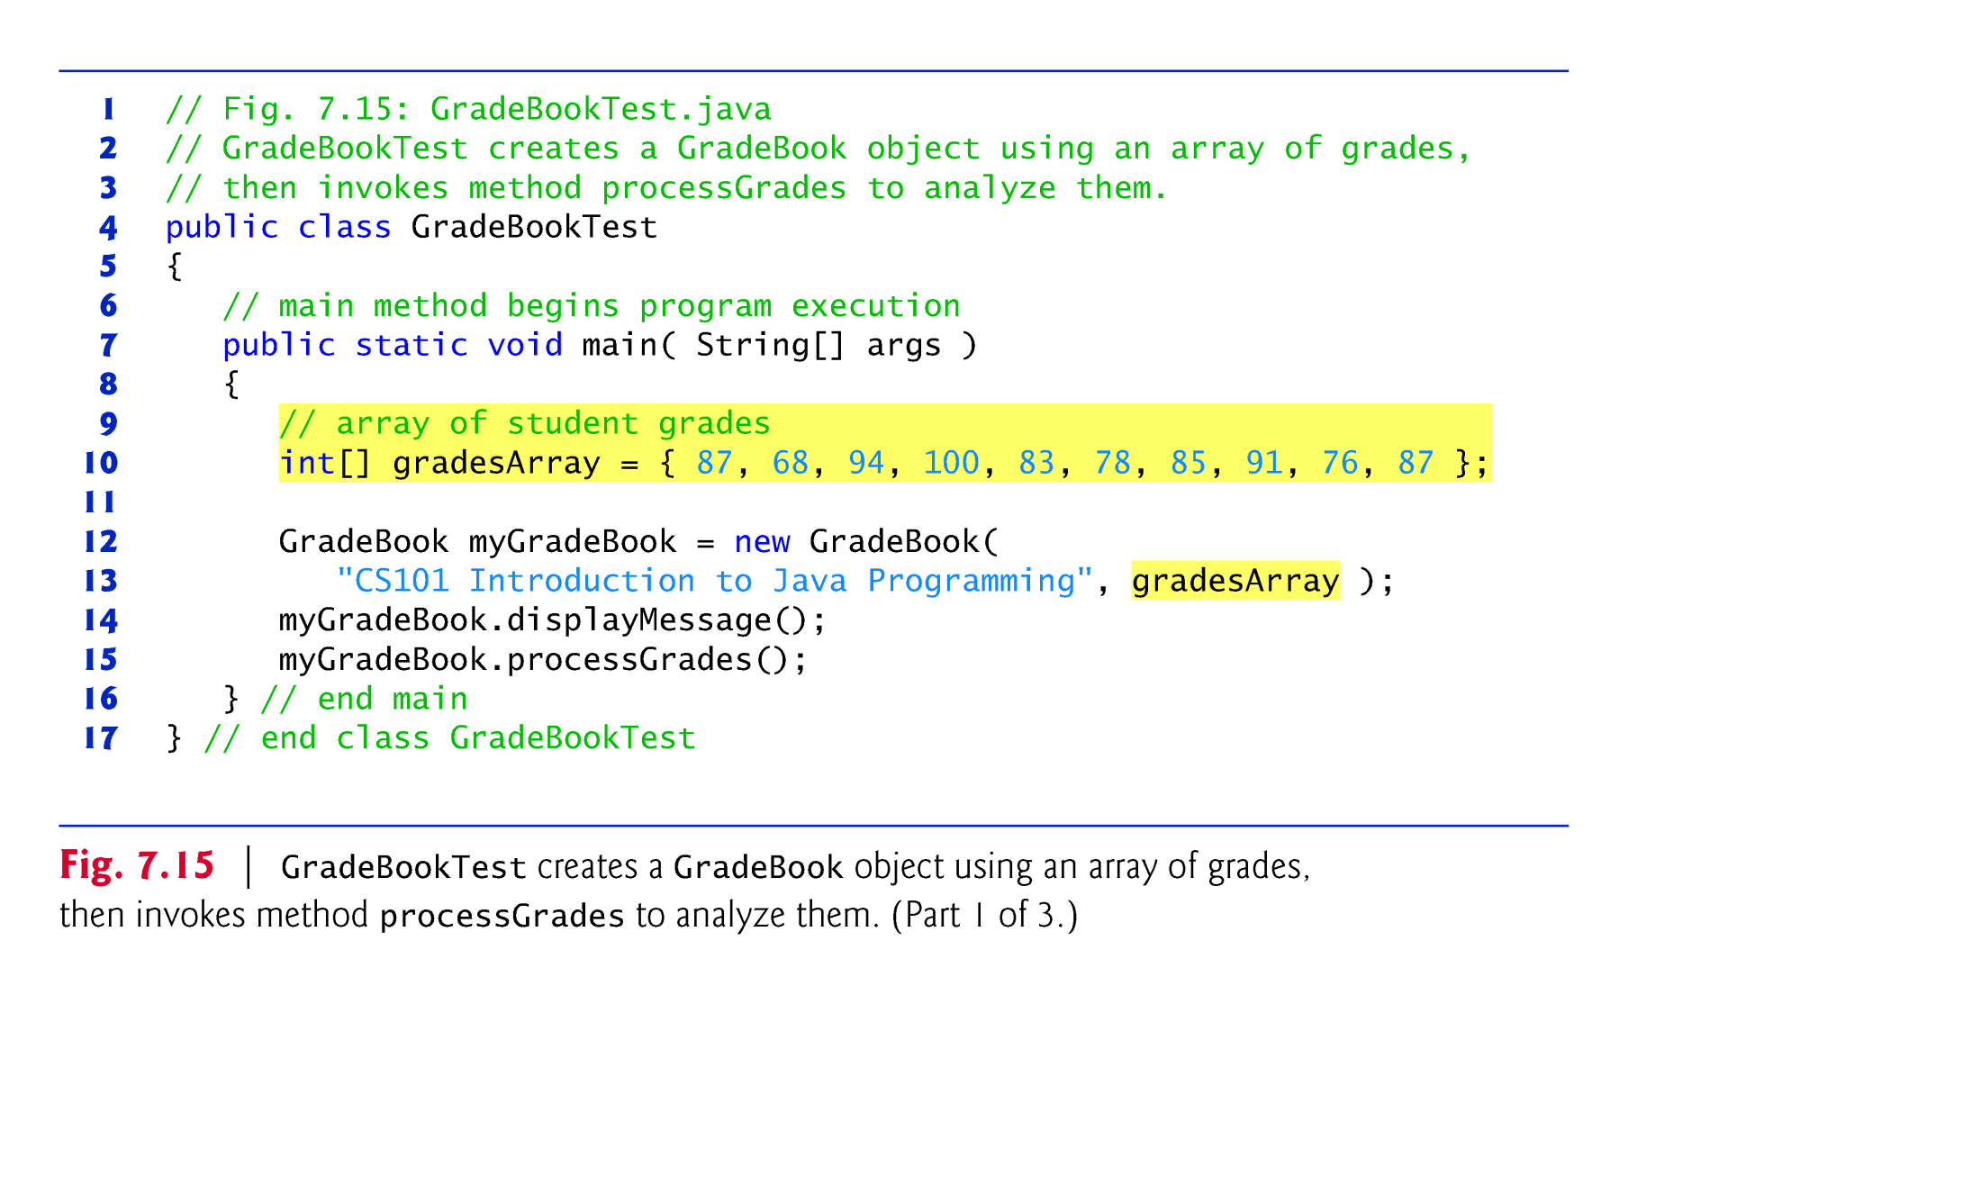

Slide 64
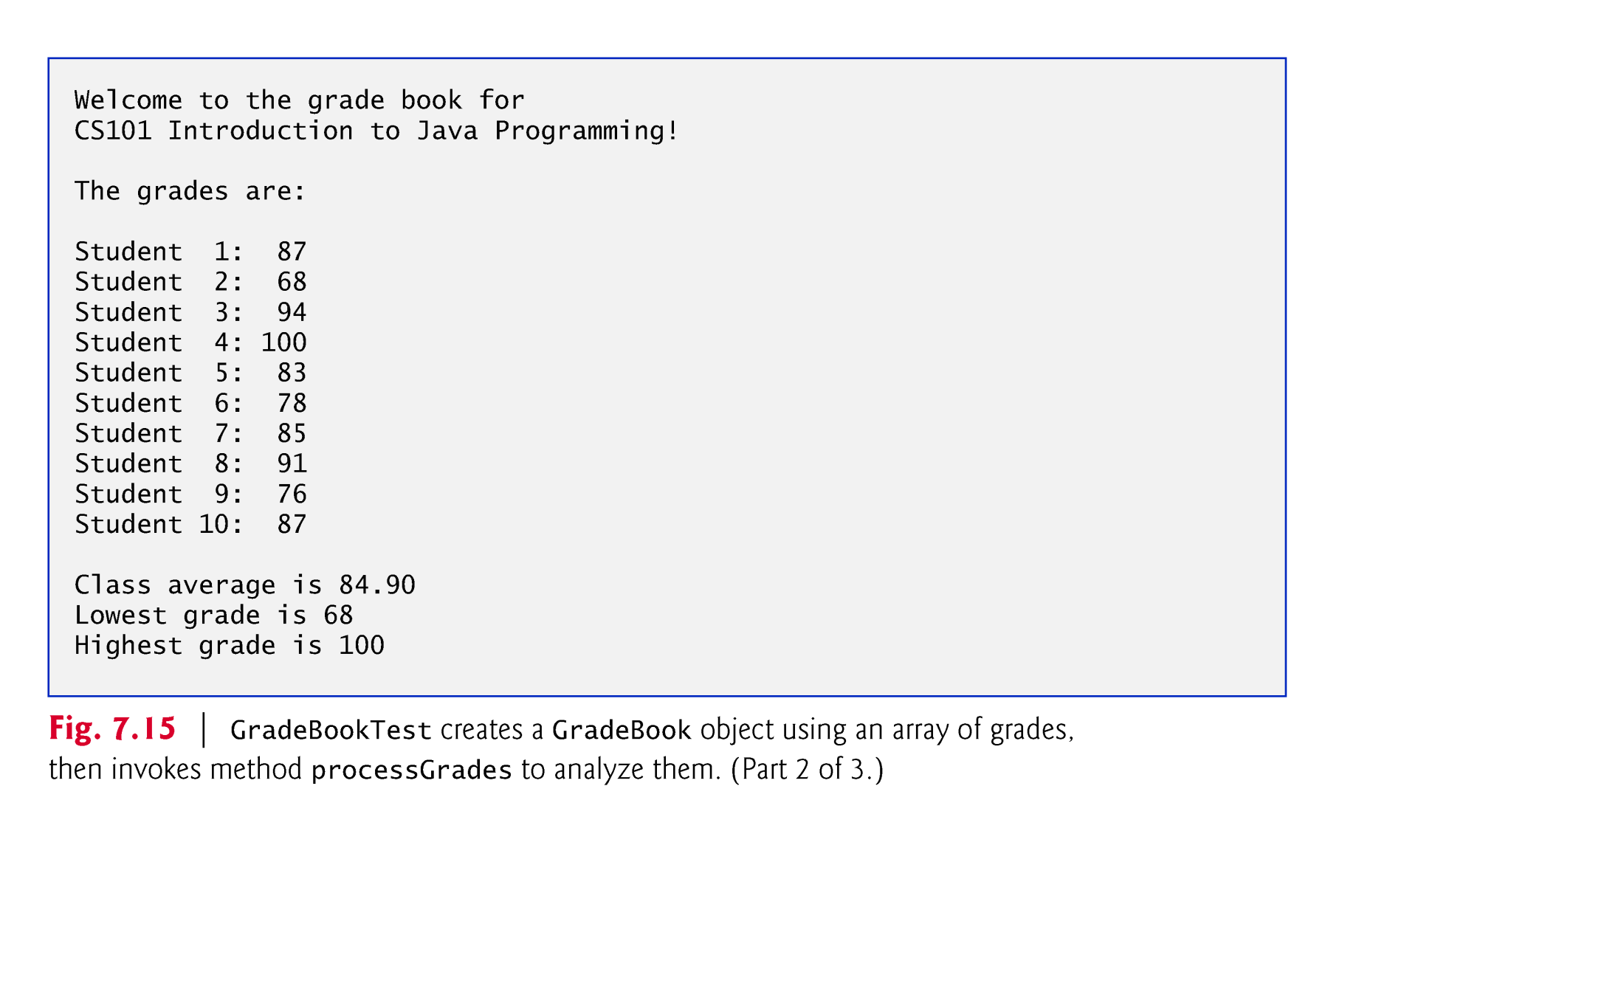

Slide 65


Slide 66
7.9 Multidimensional Arrays
Two-dimensional arrays are often used to represent tables of values consisting of information arranged in rows and columns.
Identify a particular table element with two indices.
By convention, the first identifies the element’s row and the second its column.
Multidimensional arrays can have more than two dimensions.
Java does not support multidimensional arrays directly
Allows you to specify one-dimensional arrays whose elements are also one-dimensional arrays, thus achieving the same effect.
In general, an array with m rows and n columns is called an m-by-n array.

Slide 67
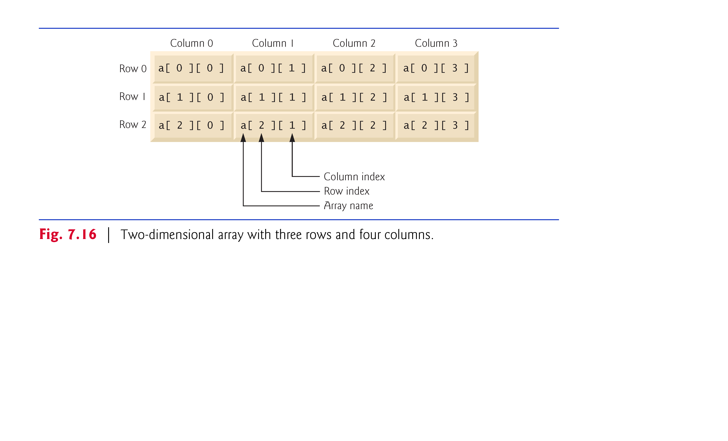

Slide 68
7.9 Multidimensional Arrays (Cont.)
Multidimensional arrays can be initialized with array initializers in declarations.
A two-dimensional array b with two rows and two columns could be declared and initialized with nested array initializers as follows:
int[][] b = { { 1, 2 }, { 3, 4 } };
The initial values are grouped by row in braces.
The number of nested array initializers (represented by sets of braces within the outer braces) determines the number of rows.
The number of initializer values in the nested array initializer for a row determines the number of columns in that row.
Rows can have different lengths.

Slide 69
7.9 Multidimensional Arrays (Cont.)
The lengths of the rows in a two-dimensional array are not required to be the same:
int[][] b = { { 1, 2 }, { 3, 4, 5 } };
Each element of b is a reference to a one-dimensional array of int variables.
The int array for row 0 is a one-dimensional array with two elements (1 and 2).
The int array for row 1 is a one-dimensional array with three elements (3, 4 and 5).

Slide 70
7.9 Multidimensional Arrays (Cont.)
A multidimensional array with the same number of columns in every row can be created with an array-creation expression.
int[][] b = new int[ 3 ][ 4 ];
3 rows and 4 columns.
The elements of a multidimensional array are initialized when the array object is created.
A multidimensional array in which each row has a different number of columns can be created as follows:
int[][] b = new int[ 2 ][ ]; // create 2 rows b[ 0 ] = new int[ 5 ]; // create 5 columns for row 0 b[ 1 ] = new int[ 3 ]; // create 3 columns for row 1
Creates a two-dimensional array with two rows.
Row 0 has five columns, and row 1 has three columns.

Slide 71
7.9 Multidimensional Arrays (Cont.)
Figure 7.17 demonstrates initializing two-dimensional arrays with array initializers and using nested for loops to traverse the arrays.

Slide 72
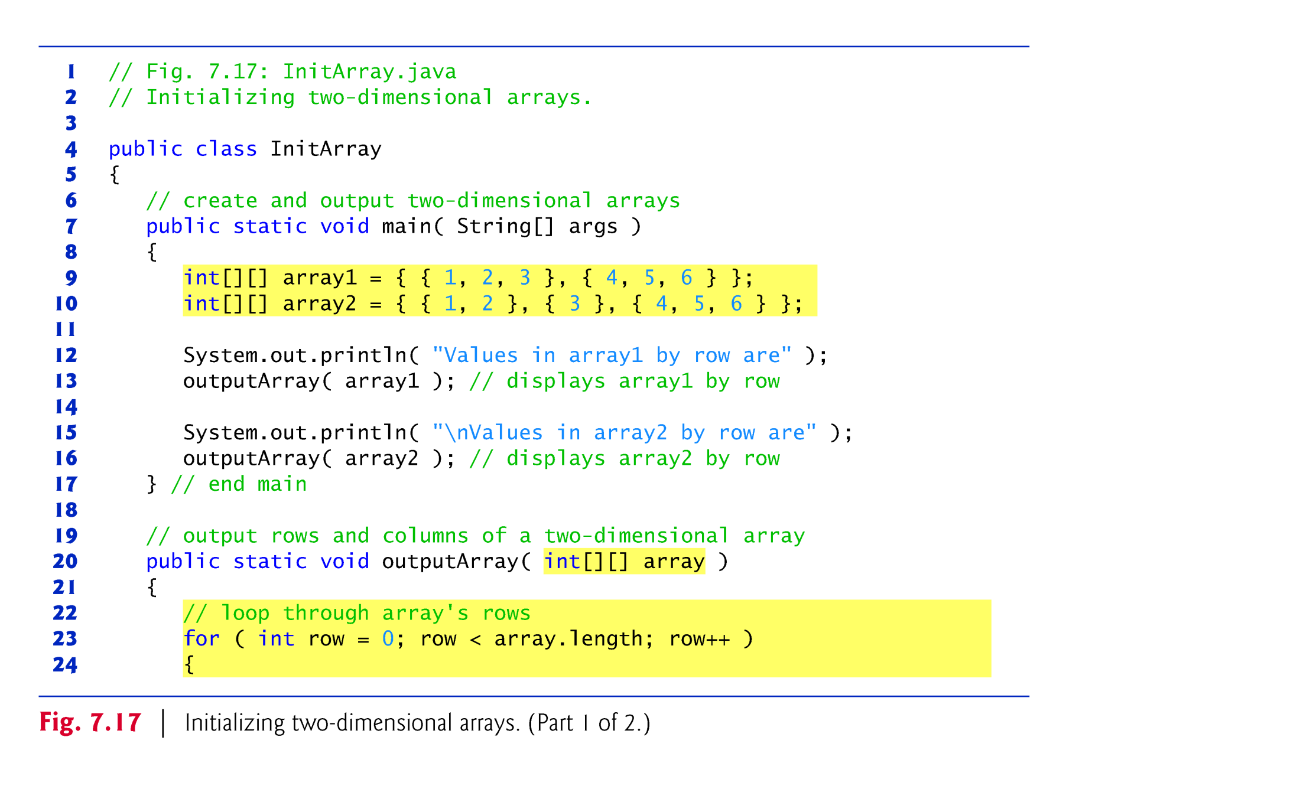

Slide 73
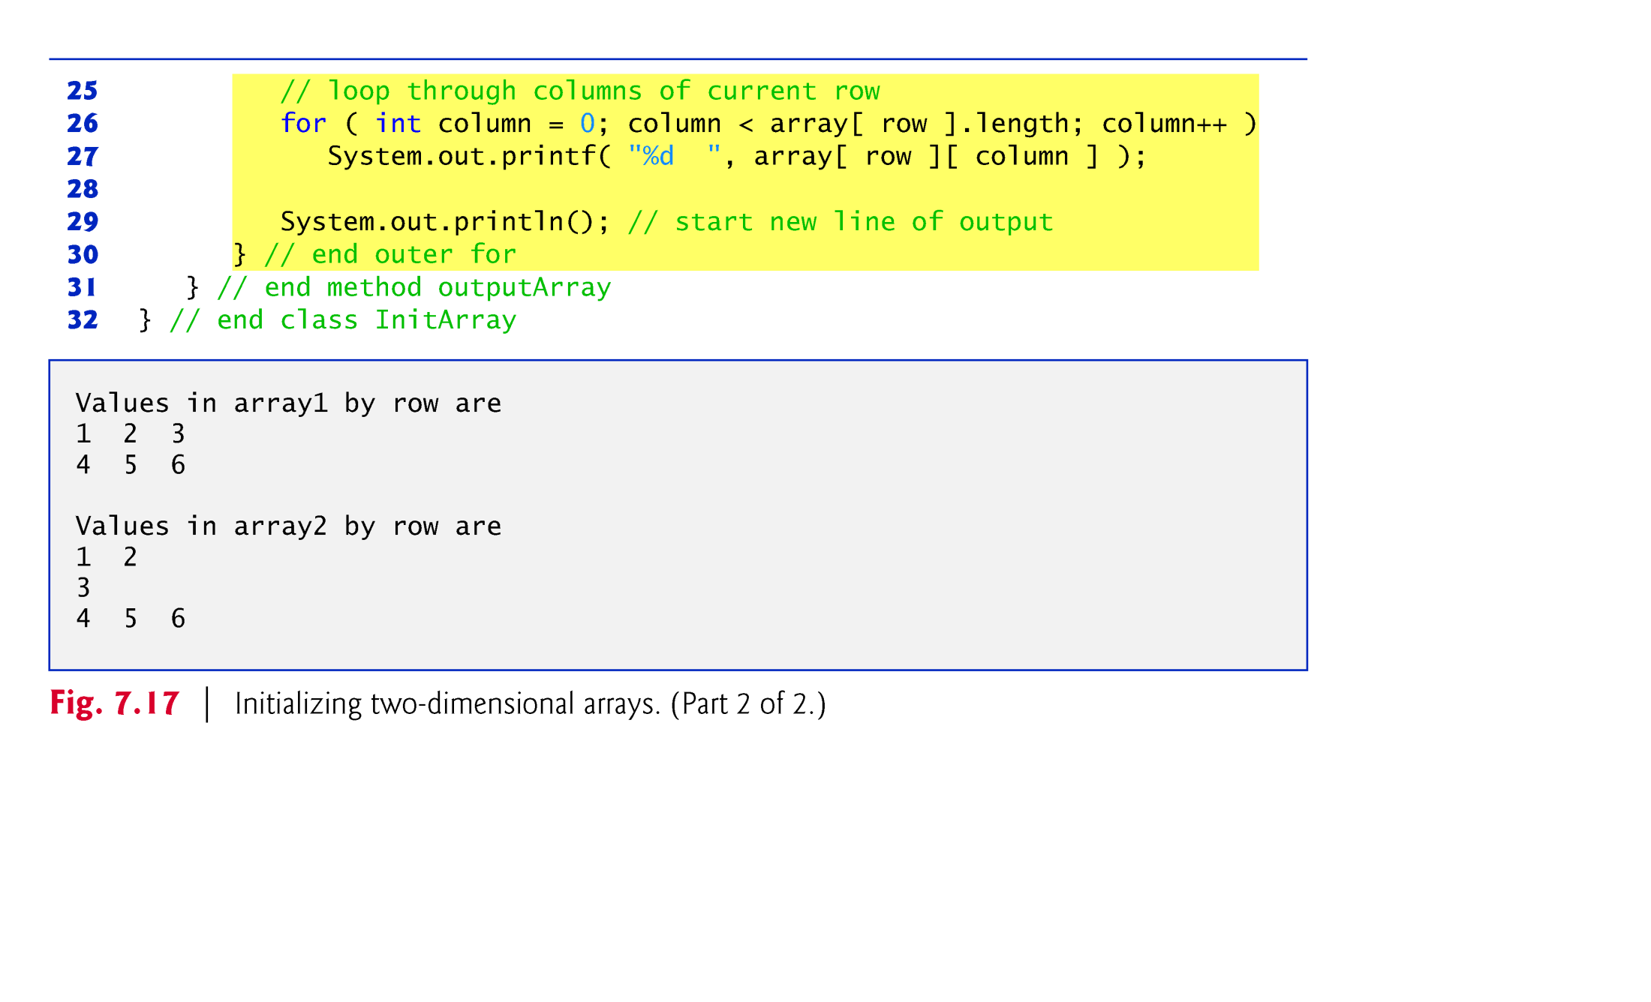

Slide 74
7.10 Case Study: Class GradeBook Using a Two-Dimensional Array
In most semesters, students take several exams.
Figure 7.18 contains a version of class GradeBook that uses a two-dimensional array grades to store the grades of a number of students on multiple exams.
Each row represents a student’s grades for the entire course.
Each column represents the grades of all the students who took a particular exam.
In this example, we use a ten-by-three array containing ten students’ grades on three exams.

Slide 75
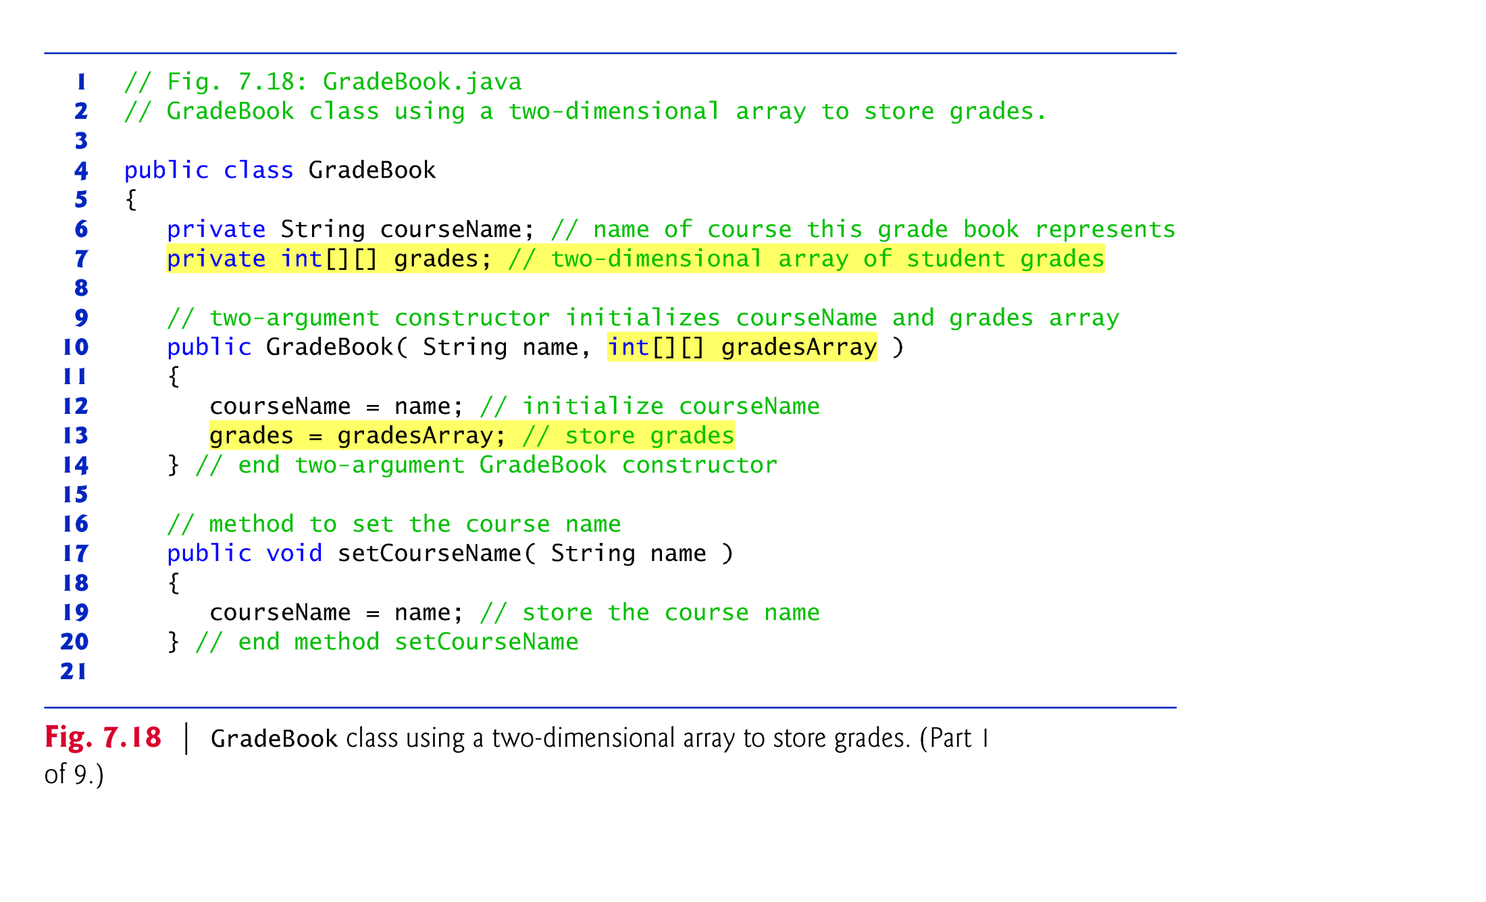

Slide 76
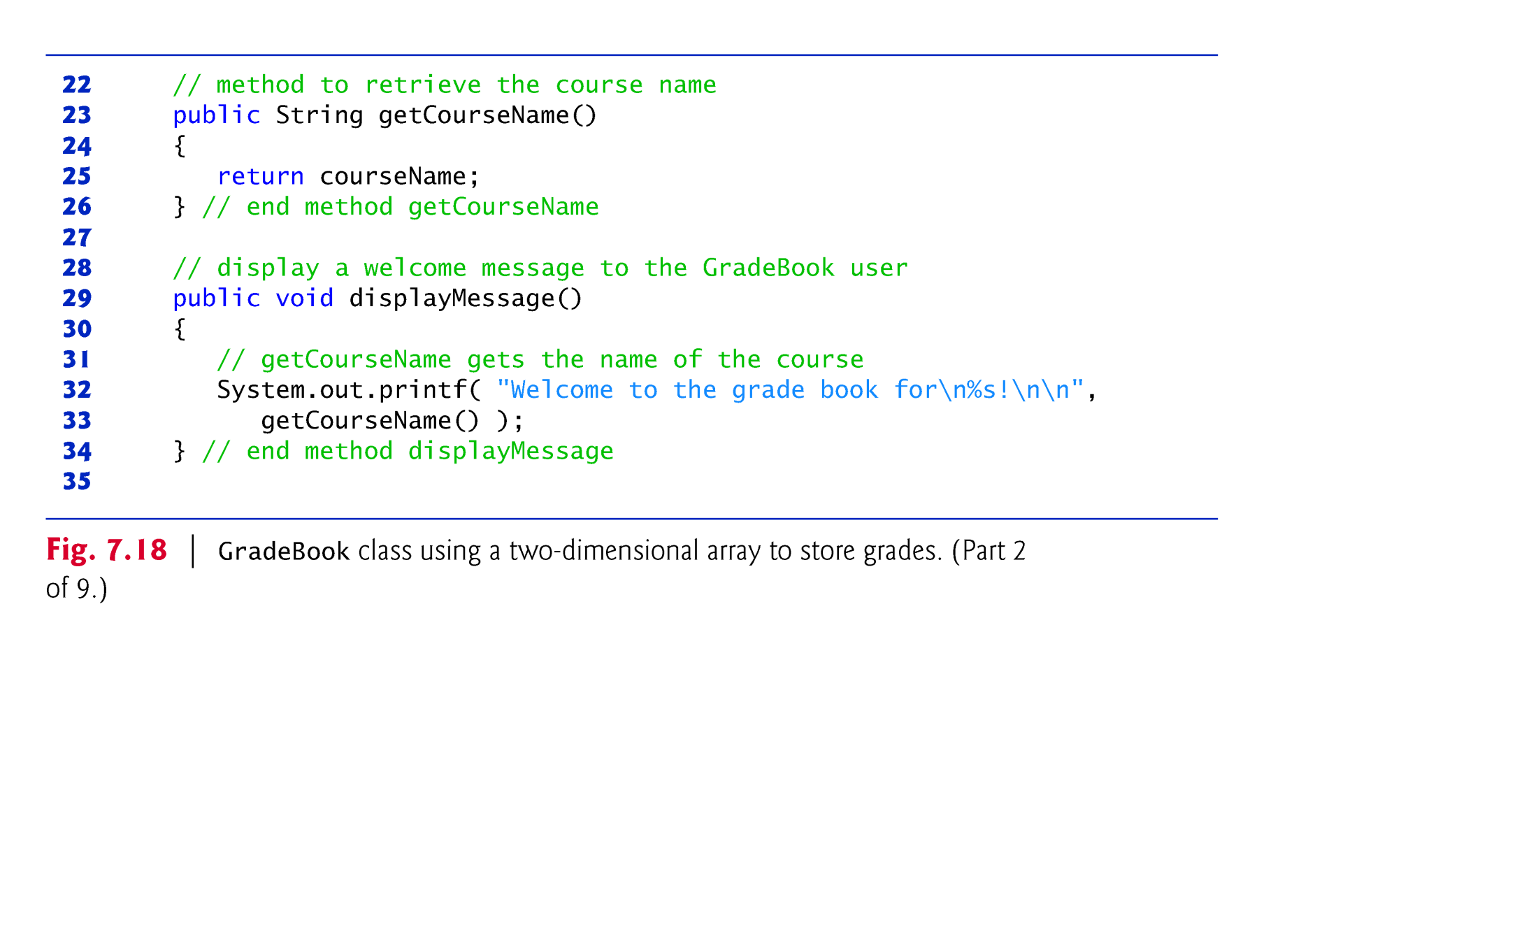

Slide 77
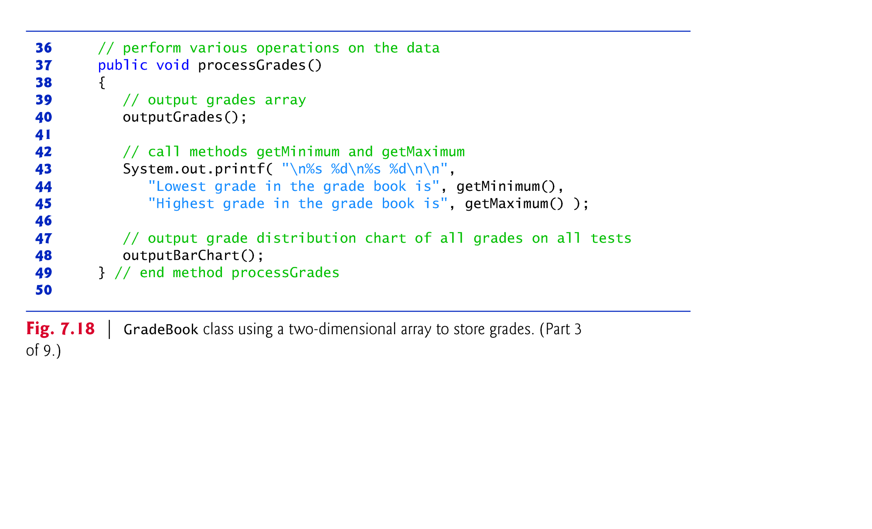

Slide 78
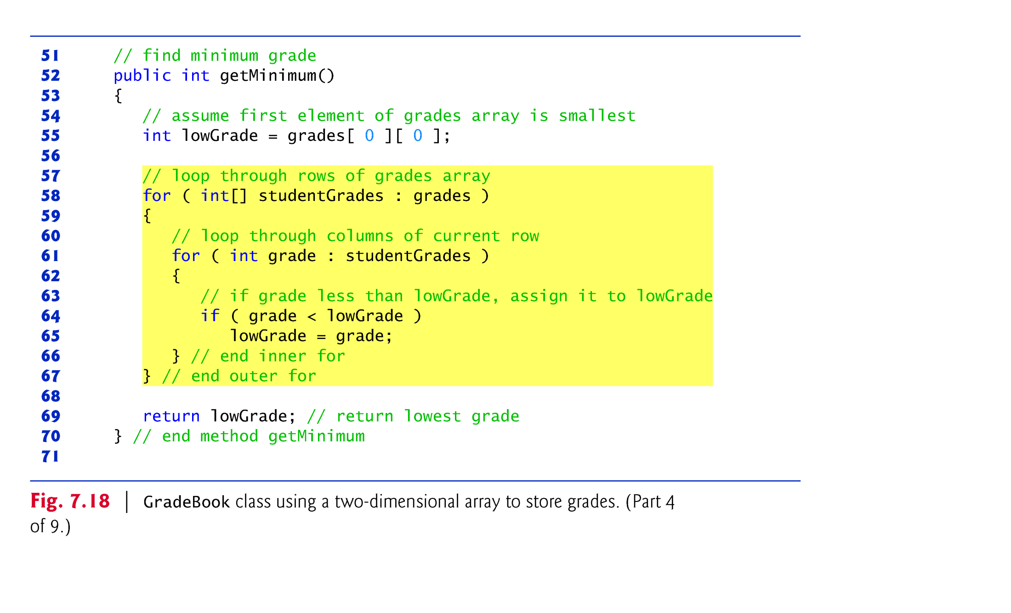

Slide 79
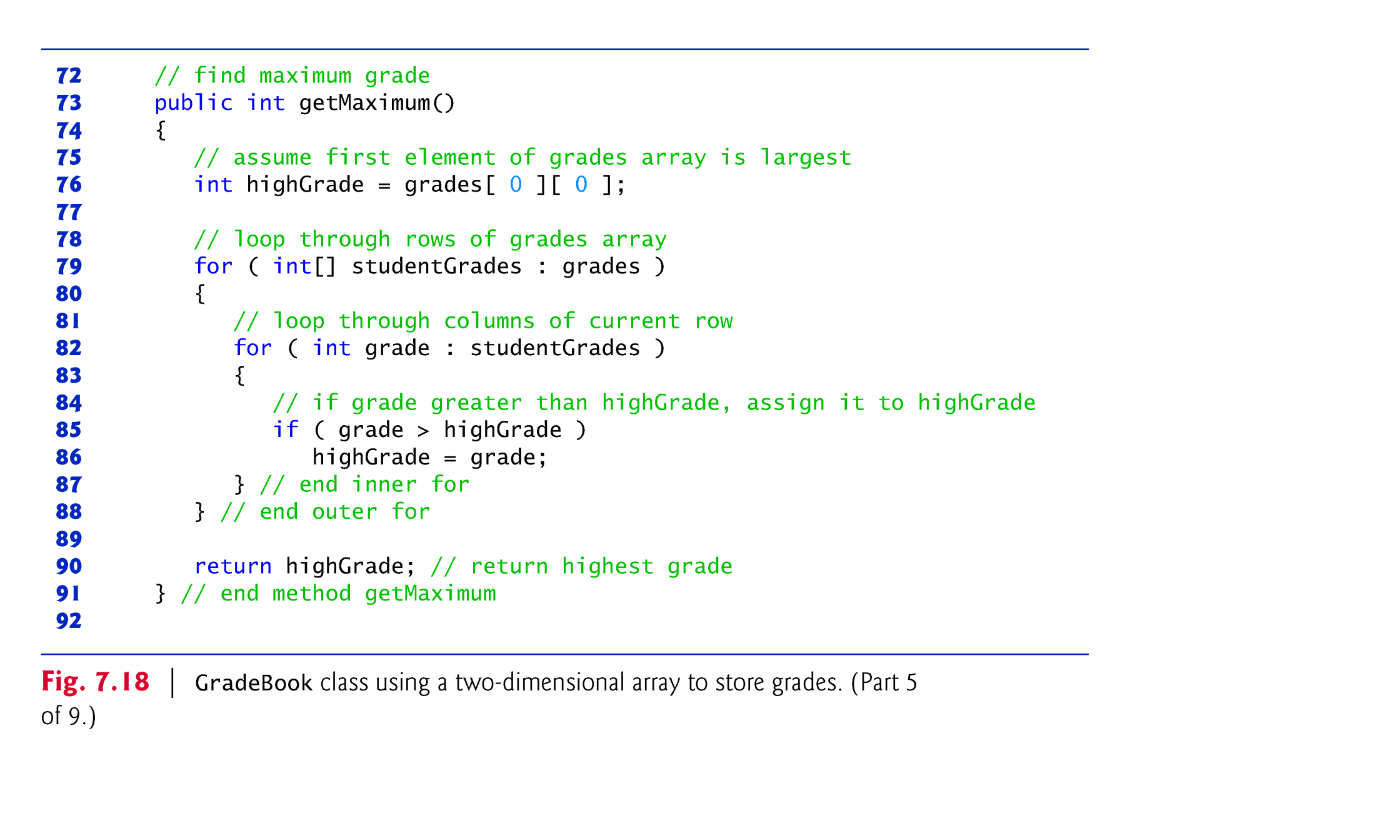

Slide 80
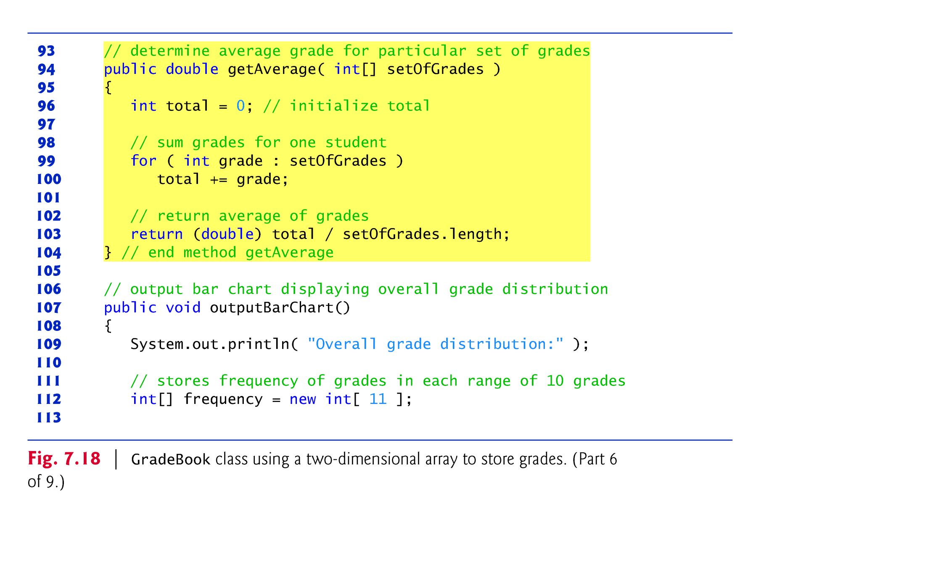

Slide 81


Slide 82


Slide 83


Slide 84


Slide 85


Slide 86


Slide 87


Slide 88
7.11 Variable-Length Argument Lists
Variable-length argument lists
Can be used to create methods that receive an unspecified number of arguments.
Parameter type followed by an ellipsis (...) indicates that the method receives a variable number of arguments of that particular type.
The ellipsis can occur only once at the end of a parameter list.

Slide 89


Slide 90


Slide 91


Slide 92
7.12 Using Command-Line Arguments
Command-line arguments
Can pass arguments from the command line to an application.
Arguments that appear after the class name in the java command are received by main in the String array args.
The number of command-line arguments is obtained by accessing the array’s length attribute.
Command-line arguments are separated by white space, not commas.

Slide 93


Slide 94


Slide 95


Slide 96
7.13 Class Arrays
Arrays class
Provides static methods for common array manipulations.
Methods include
sort for sorting an array (ascending order by default)
binarySearch for searching a sorted array
equals for comparing arrays
fill for placing values into an array.
Methods are overloaded for primitive-type arrays and for arrays of objects.
System class static arraycopy method
Copies contents of one array into another.

Slide 97


Slide 98


Slide 99


Slide 100


Slide 101


Slide 102
7.14 Introduction to Collections and Class ArrayList
Java API provides several predefined data structures, called collections, used to store groups of related objects.
Each provides efficient methods that organize, store and retrieve your data without requiring knowledge of how the data is being stored.
Reduce application-development time.
Arrays do not automatically change their size at execution time to accommodate additional elements.

Slide 103
7.14 Introduction to Collections and Class ArrayList (Cont.)
ArrayList<T> (package java.util) can dynamically change its size to accommodate more elements.
T is a placeholder for the type of element stored in the collection.
This is similar to specifying the type when declaring an array, except that only nonprimitive types can be used with these collection classes.
Classes with this kind of placeholder that can be used with any type are called generic classes.

Slide 104


Slide 105
7.14 Introduction to Collections and Class ArrayList (Cont.)
Figure 7.24 demonstrates some common ArrayList capabilities.
An ArrayList’s capacity indicates how many items it can hold without growing.
When the ArrayList grows, it must create a larger internal array and copy each element to the new array.
This is a time-consuming operation. It would be inefficient for the ArrayList to grow each time an element is added.
An ArrayList grows only when an element is added and the number of elements is equal to the capacity—i.e., there is no space for the new element.

Slide 106
7.14 Introduction to Collections and Class ArrayList (Cont.)
Method add adds elements to the ArrayList.
One-argument version appends its argument to the end of the ArrayList.
Two-argument version inserts a new element at the specified position.
Collection indices start at zero.
Method size returns the number of elements in the ArrayList.
Method get obtains the element at a specified index.
Method remove deletes an element with a specific value.
An overloaded version of the method removes the element at the specified index.
Method contains determines if an item is in the ArrayList.

Slide 107


Slide 108


Slide 109


Slide 110

7.15 （Optional) GUI And Graphics Case Study:Drawing Arcs

